Slide 1

Development of a new swelling position for PWR austenitic internals, reflecting much lower swelling compared to higher-temperature fast reactor experience
F. A. Garner
Moscow Engineering Physics Institute
Department of Material Science

Slide 2
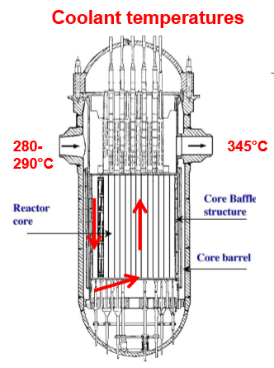
View inside of PWR core structure, showing large amount of stainless steel in baffle-former assembly
Plate and bolt construction
The majority of this structure operates at temperatures between 290 and 390 °C.

Slide 3
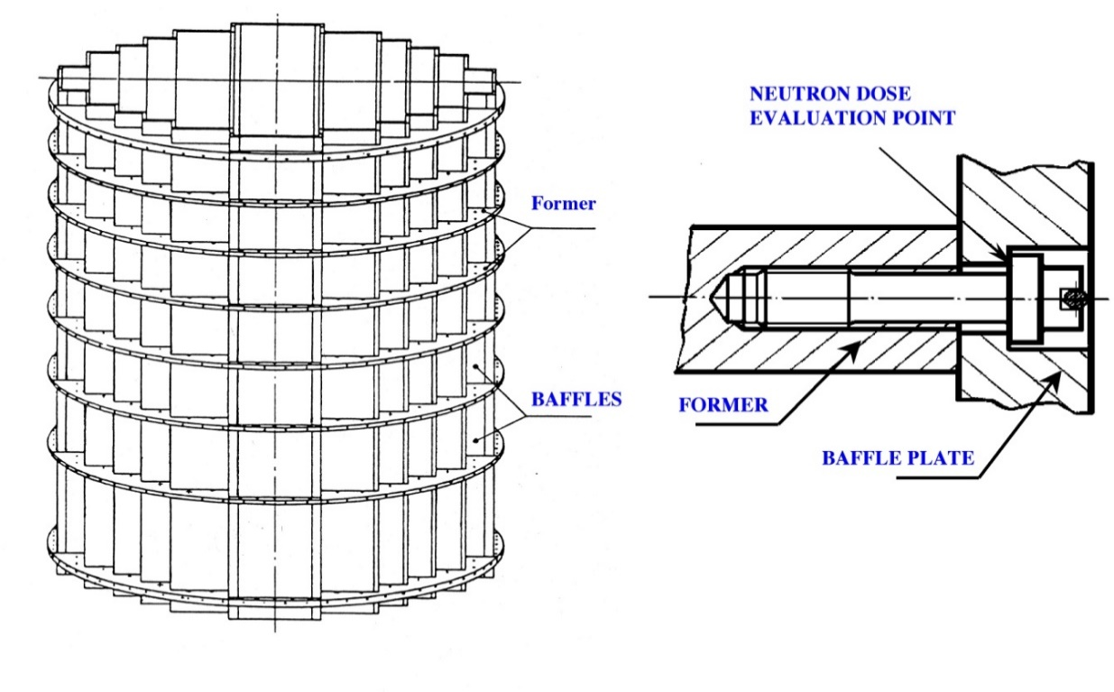
View inside of PWR core structure, showing large amount of stainless steel in baffle-former assembly
Plate and bolt construction
The majority of this structure operates at temperatures between 290 and 390 °C.

Slide 4
View inside of PWR core structure, showing large amount of stainless steel in baffle-former assembly
Plate and bolt construction
Data on PWR void swelling is accumulating slowly so most swelling data were derived from fast reactors at
higher dpa rates
different neutron spectra
lower He and H generation
higher temperatures ( >370°C)
Most of PWR structure operates at temperatures below 390 °C.
Are we certain that fast reactor data can be used to adequately forecast swelling in PWRS?

Slide 5
View inside of PWR core structure, showing large amount of stainless steel in baffle-former assembly
Plate and bolt construction
Data on PWR void swelling is accumulating slowly so most swelling data were derived from fast reactors at
higher dpa rates
different neutron spectra
lower He and H generation
higher temperatures ( >370°C)
Most of PWR structure operates at temperatures below 390 °C.
Are we certain that fast reactor data can be used to adequately forecast swelling in PWRS?
No!

Slide 6
Major questions addressed in this presentation
Are still we confident that the steady-state swelling rate of AISI 304 and other 300-series steels is ~1%/dpa at temperatures of 400°C and above?
Since most of PWR internal components are at <400°C, is it correct to assume that ~1%/dpa is also correct for PWRs?
If not correct, what is a better estimate of the swelling rate to be expected in Western design PWRs?

Slide 7
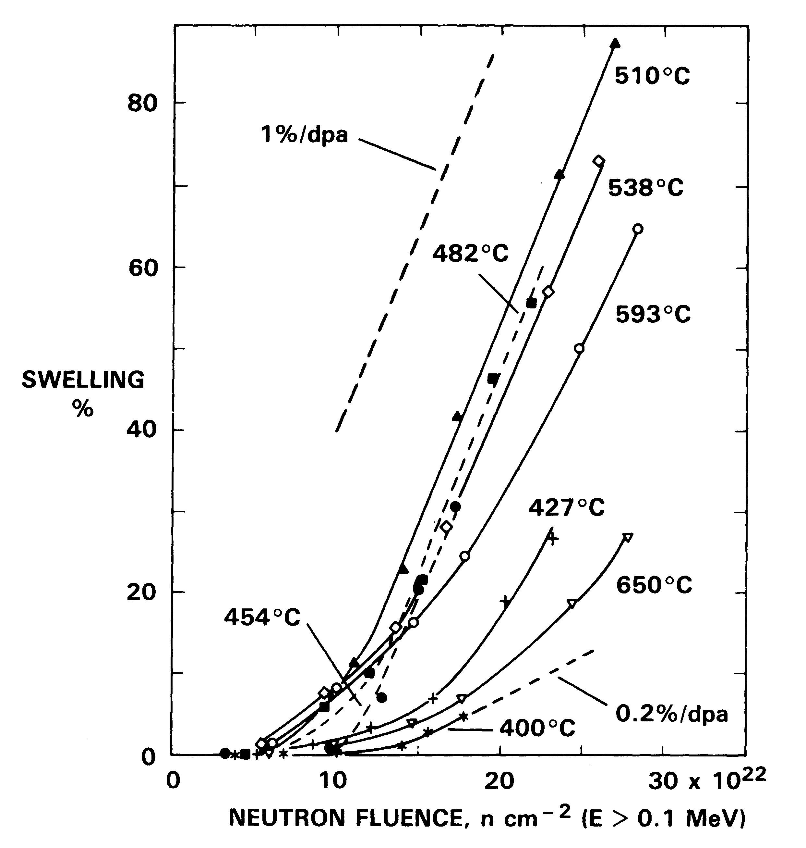
Swelling of 20% CW 316 stainless steel in EBR-II
Garner and Gelles, 1990
The most scatter-free data base involves a sequence of “reirradiation followed by reinsertion” of every specimen …. multiple times.
Swelling of austenitic stainless steels in EBR-II and FFTF almost always shows ~1%/dpa after an incubation period that depends on temperature and dpa rate.
EBR-II inlet temperature is 370°C, well above most of PWR range.

Slide 8
Swelling of 20% CW 316 stainless steel in EBR-II
Garner and Gelles, 1990
The most scatter-free data base involves a sequence of “reirradiation followed by reinsertion” of every specimen …. multiple times.
Swelling of austenitic stainless steels in EBR-II and FFTF almost always shows ~1%/dpa after an incubation period that depends on temperature and dpa rate.
EBR-II inlet temperature is 370°C, well above most of PWR range.
No clear indication of swelling behavior at near-PWR irradiation conditions.

Slide 9
Reirradiation experiments on annealed 304 stainless steel with stress changes
Garner, Flinn and Hall, 2009
Initially irradiated under stress at 477- 577°C
Then reirradiated without stress at 540-546°C
Initially irradiated without stress at 400, 450 or 550°C
Then reirradiated under stress at 450°C
Stressed to unstressed
Unstressed to stressed
Yielding no information relevant to temperature range of PWRs!

Slide 10
Loop analysis of long through-core components: previous studies involving 304 stainless steel
Garner, 2008
Capsules on fuel pins in EBR-II
EBR-II control rod duct
Constant-time experiments with no material contributions to data scatter and having a continuous smooth transition in irradiation conditions

Slide 11
Loop analysis of long through-core components: previous studies involving 304 stainless steel
Garner, 2008
Under some conditions there are ranges of temperature-flux combinations with no variation in transient.
Capsules on fuel pins in EBR-II
EBR-II control rod duct
Assuming that a high enough dose every data point lies on a 1%/dpa line with an individual transient duration

Slide 12
Swelling of annealed 304 stainless steel cladding in three fuel assemblies in EBR-II
Garner, Makenas, Chastain, 2011
Row 3 low power Row 4 medium power Row 5 high power
% swelling
“skinny loops”
1%/dpa
Fluence, 10²⁶ n/m² E>0.1 MeV
Swelling loops become thinner (skinny) as the upper temperature increases and loops can become a single line for some conditions.

Slide 13
Swelling of annealed 304 stainless steel cladding in three fuel assemblies in EBR-II
Garner, Makenas, Chastain, 2011
Note the strong reproducibility and minimum scatter of swelling for pins having nearly identical irradiation conditions.
Row 3 low power Row 4 medium power Row 5 high power
% swelling
“skinny loops”
1%/dpa
Fluence, 10²⁶ n/m² E>0.1 MeV
Swelling loops become thinner (skinny) as the upper temperature increases and loops can become a single line for some conditions.

Slide 14
Pressure vessel internals of Western PWRs are accumulating damage dose at a maximum rate of ~2 dpa/year.
The primary construction steel is AISI 304 stainless steel.
Most void swelling data on this steel was derived from the EBR-II fast reactor at a maximum in-core rate of 15 dpa/year.
Some out-of-core reflector experiments in EBR-II were conducted at a range of low dpa rates that were characteristic of PWRs.
In 1997-1998 five EBR-II reflector and blanket assemblies were used to develop a swelling equation for PWR application.

Slide 15
Pressure vessel internals of Western PWRs are accumulating damage dose at a maximum rate of ~2 dpa/year.
The primary construction steel is AISI 304 stainless steel.
Most void swelling data on this steel was derived from the EBR-II fast reactor at a maximum in-core rate of 15 dpa/year.
Some out-of-core reflector experiments in EBR-II were conducted at a range of lower dpa rates that were characteristic of PWRs.
In 1997-1998 five EBR-II reflector and blanket assemblies were used to develop a swelling equation for PWR application.

Slide 16
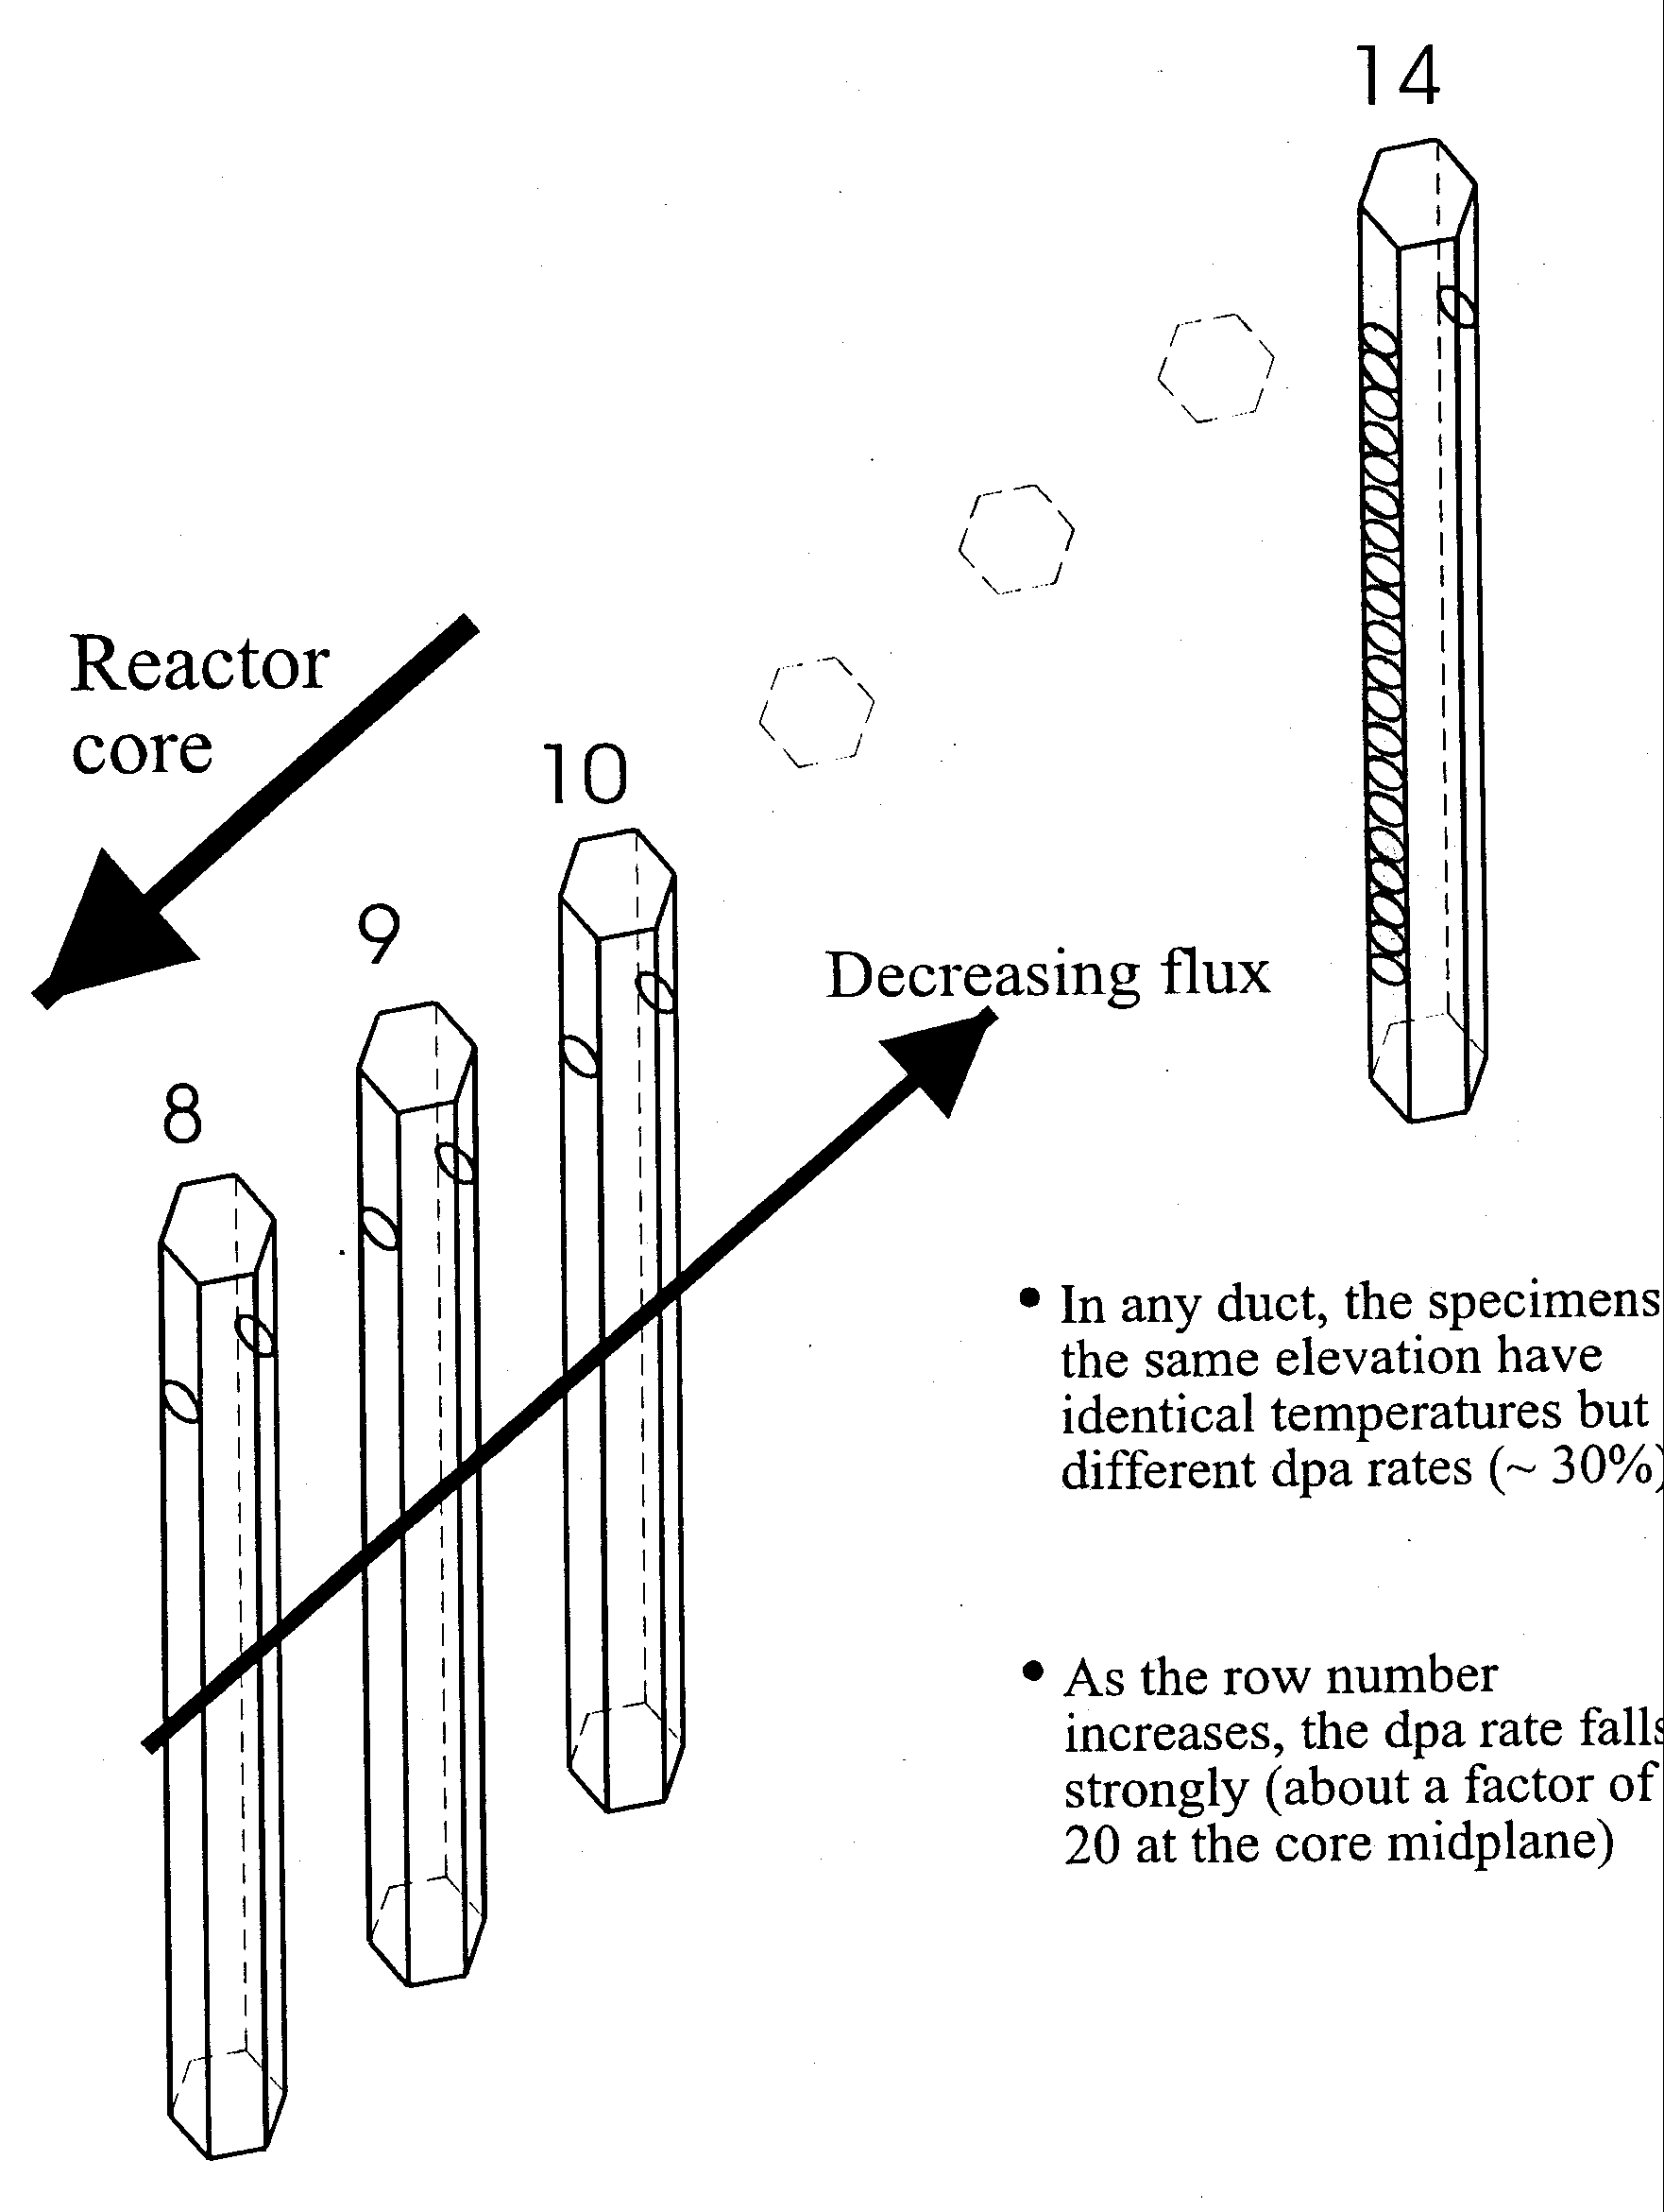
Flux-dependent swelling equation for SA 304 was developed for APWR predictions
Garner et al., 2000
5 hexagonal ducts from identical SA 304 heat
Rows 8-10 in reflector and row 14 of blanket of EBR-II
2 cm disks punched for density change and microscopy
Total of 280 disks
372-440°C and 2-32 dpa
Range of PWR-relevant dpa rates.
Rows 1-6 form the fueled core
Two Row 10 assemblies on opposite sides of the reactor
ΔV/V =A(T) (dpa rate)^{-0.731}(dpa)²
^{With 1%/dpa as maximum rate}

Slide 17
Comparison of swelling in two Row 10 assemblies on opposite sides of the reactor
Data shown from bottom half of ducts only to keep temperature as close to PWR-relevant as possible.
Data shown only from bottom half of the assemblies
~16% difference in dpa rate.
Lower dpa rate leads to earlier swelling.

Slide 18
Comparison of swelling observed in Rows 8-14
Data shown from bottom half of ducts only to keep temperature as close to PWR-relevant as possible.
Decrease in the dpa rate leads to a progressive shortening in the duration of the transient regime.
Highest swelling rate in this data set is ~0.3%/dpa.

Slide 19
“Modified Foster-Flinn” empirical equation for swelling of annealed 304 stainless steel
S = (dpa)² (dpa rate)^{–0.731} F(T)
where F(T) = EXP (22.106 – (18558/(T + 273.15)))
with swelling S given in %,
temperature T in °C
and dpa rate is in units of 10^{–7} dpa/sec.
Transient curvature dictated by (dpa)² term and swelling rate will eventually exceed 1%/dpa.
Swelling rate is required not to exceed 1%/dpa, but this rate is mandated to eventually occur at all temperatures of PWR interest.

Slide 20
“Modified Foster-Flinn” empirical equation for swelling of annealed 304 stainless steel
Swelling increases with increasing dose
Swelling deceases with increasing dose rate by increasing the transient regime.
S = (dpa)² (dpa rate)^{–0.731} F(T)
where F(T) = EXP (22.106 – (18558/(T + 273.15)))
with swelling S given in %,
temperature T in °C
and dpa rate is in units of 10^{–7} dpa/sec.
Transient curvature dictated by (dpa)² term and swelling rate will eventually exceed 1%/dpa.
Swelling rate is required not to exceed 1%/dpa, but this rate is mandated to eventually occur at all temperatures of PWR interest.

Slide 21
“Modified Foster-Flinn” empirical equation for swelling of annealed 304 stainless steel
Arbitrarily fit to an out-dated perception of fast reactor swelling.
S = (dpa)² (dpa rate)^{–0.731} F(T)
where F(T) = EXP (22.106 – (18558/(T + 273.15)))
with swelling S given in %,
temperature T in °C
and dpa rate is in units of 10^{–7} dpa/sec.
Transient curvature dictated by (dpa)² term and swelling rate will eventually exceed 1%/dpa.
Swelling rate is required not to exceed 1%/dpa, but this rate is mandated to eventually occur at all temperatures of PWR interest.
No longer thought to be correct at PWR temperatures!

Slide 22
Comparison of swelling observations in PWRs with predictions of swelling
Have voids been observed in PWRs and BWRs? Yes
Has swelling ever been observed at >1%? No
Has a swelling rate approaching 1%/dpa ever been observed in a PWR? No
The major problem is that EBR-II had an inlet temperature of 370°C and a large fraction of the PWR internal components operate below that temperature.
Is there a transition to a lower rate of swelling near ~370°C ?
Can we see this lower rate using EBR-II components, focusing on low flux, low temperature conditions?

Slide 23
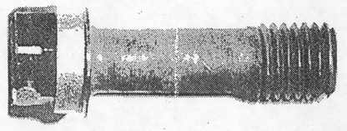
Voids observed at ~340°C and 12 dpa in PWR Tihange baffle-former bolt (cold-worked 316 stainless steel)
D. J. Edwards, F. A. Garner, B. A. Oliver and S. M. Bruemmer, 2001
~0.2% swelling
This steel was previously thought to be very resistant to swelling under LWR-relevant conditions.
The majority of the internal structure of LWRs is composed of annealed 304 stainless which is much more prone to swelling.

Slide 24
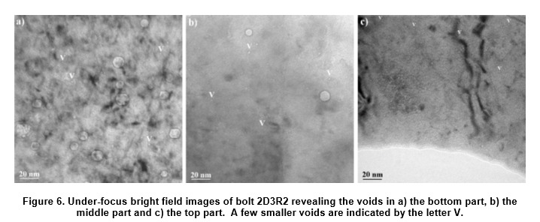
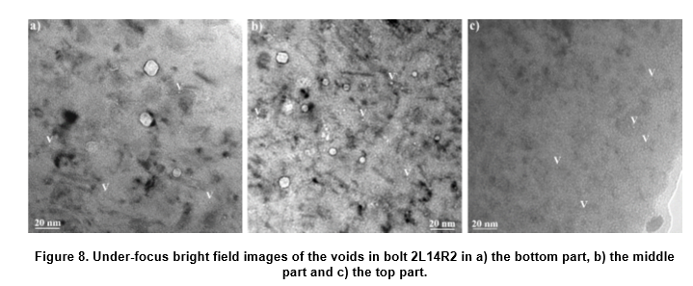
Bottom middle top
0.15%
0.21%
0.017%
Van Renterghem, Bosch, Gerard, Somville, 2018
Fontevraud 9
35 to 13 dpa
320 to 343°C
At doses of 35-40 dpa and temperatures below 350°C, swelling in CW 316 PWR baffle bolts precedes at a very low rate.
0.08%
0.11%
0.025%
40.5 to 15.3 dpa
333 to 343 °C

Slide 25
Comparison of swelling observations in PWRs with predictions of swelling
Have voids been observed in PWRs and BWRs? Yes
Has swelling ever been observed at >1%? No
Has a swelling rate approaching 1%/dpa ever been observed in a PWR? No
The major problem is that EBR-II had an inlet temperature of 370°C and a large fraction of the PWR internal components operate below that temperature.
Is there a transition to a lower rate of swelling near ~370°C ?
Can we see this lower rate using EBR-II components, focusing on low flux, low temperature conditions?

Slide 26
There have been a number of studies that showed lower swelling rates below 400°C
Reactors with lower inlet temperatures
DFR, BOR-60, BN-350
EBR-II experiments (370°C inlet)
conducted in the reflector region
conducted as temperature change experiments
FFTF experiments (365°C inlet)
not covered in this presentation

Slide 27
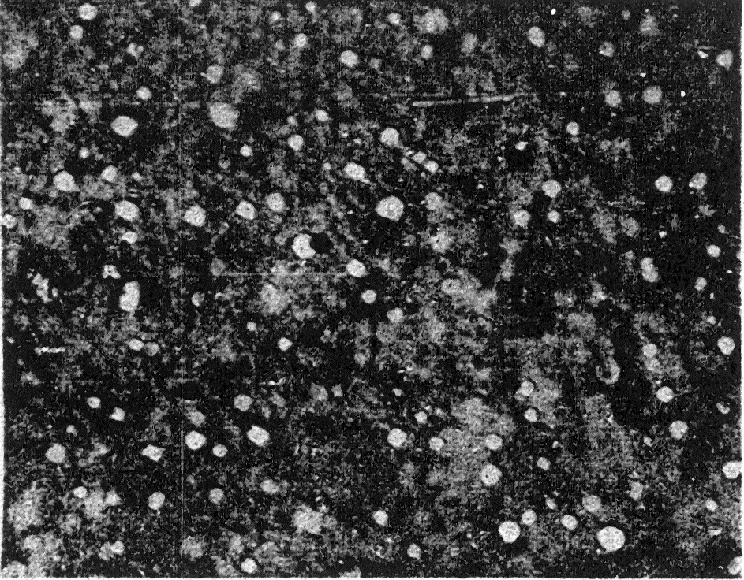
C. Cawthorne and
E. J. Fulton, “Voids in Irradiated Stainless Steel,” Nature, Vol. 216, November 11, 1967
At highest dose and ~380°C no swelling was observed.

Slide 28
Swelling of cold-worked M316 fuel cladding in DFR with inlet temperature of 270°C
C. Cawthorne, U.S./U.K. Exchange, 1979
Peak flux
Increasing temperature
Very low inlet temperature of ~270°C

Slide 29
Swelling of cold-worked M316 fuel cladding in DFR with inlet temperature of 270°C
C. Cawthorne, U.S./U.K. Exchange, 1979
Increasing temperature
Breakaway temperature is ~370°C
breakaway

Slide 30
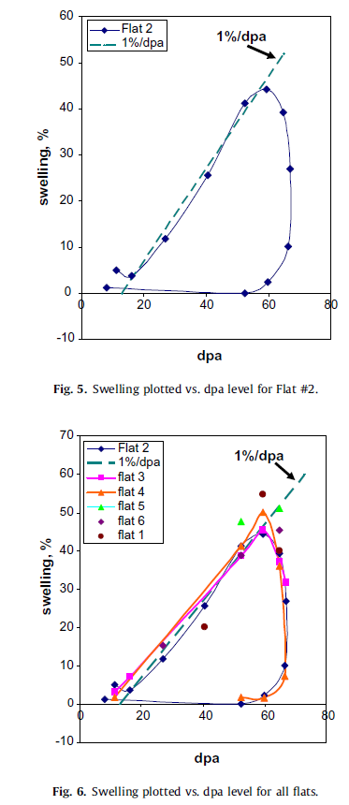
BOR-60 has a lower inlet temperature of 320-330°C, depending on the season, allowing an opportunity to probe the full range of swelling rate.
Breakaway in the 360-390°C interval
Neustroev and Garner, 2008
Density change data derived from all six faces of a duct

Slide 31
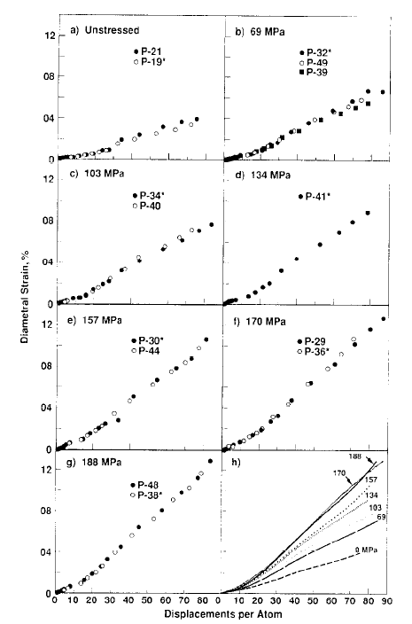
Irradiation creep and swelling of gas-pressurized tubes of annealed 304L stainless steel irradiated at 380-390°C in Row 7 in EBR-II
Porter, Hudman and Garner, 1991
Two unstressed tubes show very reproducible behavior with a swelling rate that varies from ~0.07 to 0.18%/dpa between 380 and 390°C.

Slide 32
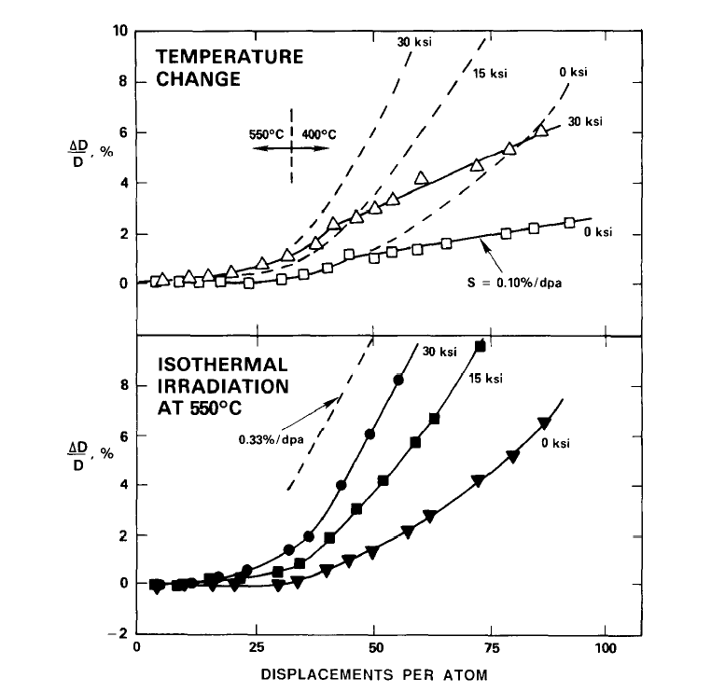
Diameter changes observed in two sets of 20% cold-worked 316 stainless gas-pressurized tubes, one irradiated isothermally and another subjected in a temperature drop from 550 to 400°C.
Garner, Porter, 1988
Maximum strain rate arising from creep and swelling can never exceed 0.33%/dpa.
0.33%/dpa is one-third of 1.0%/dpa, the maximum swelling rate.
Radiation at 550°C moves toward 1%/dpa, but a downward change to 400°C drops the swelling rate to ~0.1%/dpa.

Slide 33
Loop analysis of long through-core components: previous studies
Garner, 2008
Capsules on fuel pins in EBR-II
EBR-II control rod duct
Row 3
Can we extract any information relevant to PWR conditions from such curves at the lowest range of dpa rates and temperatures, especially focusing on out-of-core components?

Slide 34
Swelling rate of ~1%/dpa is routinely observed for temperatures above 370-380°C
Might there be a lower intrinsic swelling rate of 300 series stainless steels at PWR-relevant fluxes and temperatures?
Can we see some indication of this lower rate using the loop analysis technique for EBR-II reflector subassemblies?
Focus on components with lowest dpa rates and with temperatures closest to 370°C inlet of EBR-II, getting as close as possible to conditions experienced by PWR internals.

Slide 35
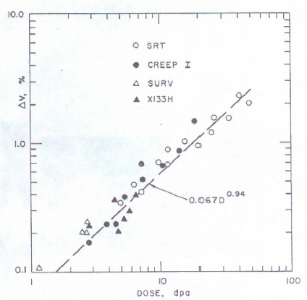
Swelling of annealed 304 SS at ~370-390°C over a wide range of dpa rates
Johnson and Hofmann, 1977
Swelling (measured by TEM) vs. dpa for four separate experiments conducted in rows 3 to 12 of EBR-II fast reactor.
The swelling rate of this prolonged transient is ~0.067%/dpa.
These data were published in an obscure abstract and their value was unappreciated by the radiation damage community and was unfortunately ignored.

Slide 36
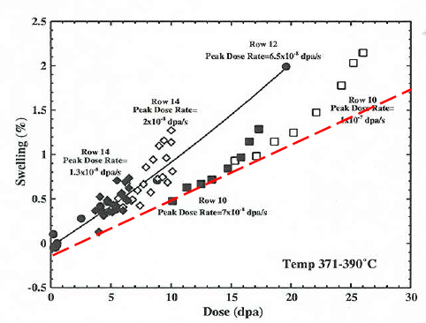
Dependence of swelling in annealed 304 stainless steel as observed in Rows 10, 12 and 14 of EBR-II
Allen, Garner and coworkers, 2006
Red dashed line is the 0.067%/dpa correlation of Hofman and Johnson, adjusted to account for carbide densification.
There appears to be a lower transient swelling rate that serves as a floor for the swelling regime.
Depending on values of flux, temperature or stress, swelling eventually lifts off this lower slope line.

Slide 37
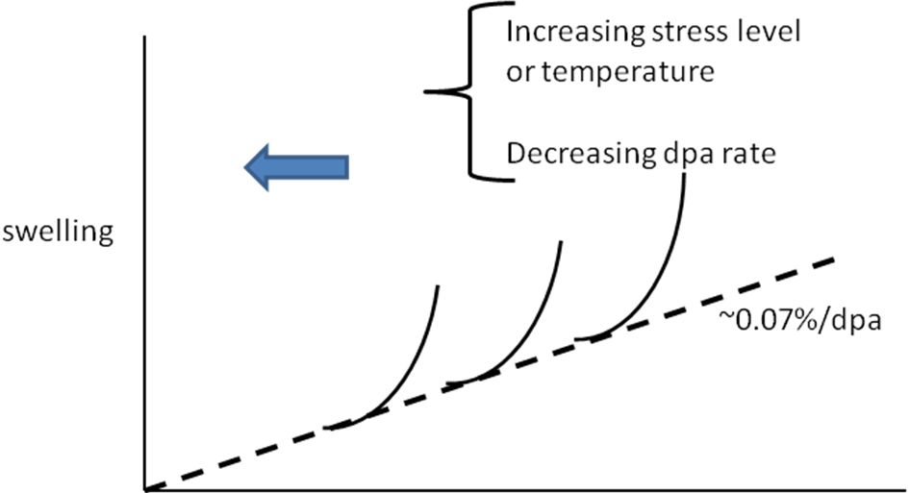
Dependence of swelling in annealed 304 stainless steel as observed in Rows 10, 12 and 14 of EBR-II
Allen, Garner and coworkers, 2006
Eventual “breakaway” to higher swelling rate regime depending on environmental variables.

Slide 38
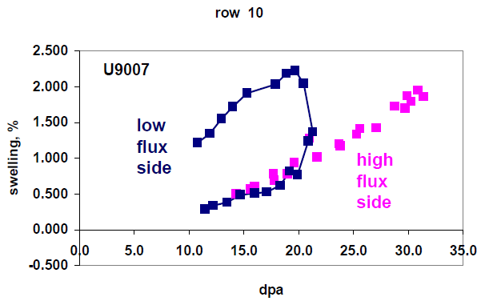
Swelling loops seen on one Row 10 duct used to establish the current swelling equation for 304 SS
Two row 10 ducts on opposite side of EBR-II

Slide 39
Swelling loops seen on one Row 10 duct used to establish the current swelling equation for 304 SS
Note that high flux side of duct stays on one “skinny loop” path but the low flux side breaks away to a higher swelling rate.

Slide 40
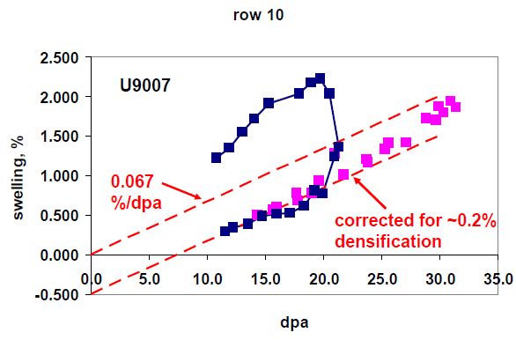
Swelling loops seen on one Row 10 duct used to establish the current swelling equation for 304 SS

Slide 41
Two ducts in row 10 of EBR-II but with ~16% difference in dpa rate
As dpa rate decreases there is a tendency to form loops, indicating a transition from a low swelling rate to a higher swelling rate.

Slide 42
Two ducts in row 10 of EBR-II but with ~16% difference in dpa rate
Continuous transition from skinny loop to fat loop as dpa rate decreases.
Transition from low-rate to high-rate regimes.
As dpa rate decreases there is a tendency to form loops, indicating a transition from a low swelling rate to a higher swelling rate.

Slide 43
Swelling observed in four faces of a hexagonal flux thimble tube in row 5 of EBR-II (dpa rates intermediate to PWR values)
Temperatures are very similar for different duct faces but there are significant differences in neutron flux.
It was expected that the difference in neutron fluxes on the various faces would cause the swelling to be different on each face and therefore the duct would bend.
Neither of these expectations was realized.

Slide 44
Swelling observed in four faces of a hexagonal flux thimble tube in row 5 of EBR-II (dpa rates intermediate to PWR values)
Temperatures are very similar for different duct faces but there are significant differences in neutron flux.
The swelling was essentially identical on all four faces.

Slide 45
Swelling observed in four faces of a hexagonal flux thimble tube in row 5 of EBR-II (dpa rates intermediate to PWR values)
Temperatures are very similar for different duct faces but there are significant differences in neutron flux.

Slide 46
Swelling observed in four faces of a hexagonal flux thimble tube in row 5 of EBR-II (dpa rates intermediate to PWR values)
Temperatures are very similar for different duct faces but there are significant differences in neutron flux.
Transition to a lower steady-state rate?

Slide 47
Conclusions
The modified Foster-Flinn equation is an improvement over earlier equations in that it explicitly accounts for the effect of dpa rate.
The equation is based on data only above 370°C, introducing considerable uncertainty into predictions at lower temperatures.
1%/dpa still appears to be a universal swelling rate at “high” (>360-380°C) temperatures, but there is evidence of a transition regime to lower swelling rates, most evident at lower dpa rates.
For “lower” PWR-relevant temperatures a bounding swelling estimate might better be ~0.07%/dpa, serving as a universal rate for the so-called “transient” regime that may actually persist to very high dose.
The “breakaway” to higher rate appears to occur at ~360-380°C.
A new swelling equation is required for PWR applications.
Much of the PWR internals may never reach a swelling rate of ~1%/dpa.

Slide 48
Conclusions
The modified Foster-Flinn equation is an improvement over earlier equations in that it explicitly accounts for the effect of dpa rate.
The equation is based on data only above 370°C, introducing considerable uncertainty into predictions at lower temperatures.
1%/dpa still appears to be a universal swelling rate at “high” (>360-380°C) temperatures, but there is evidence of a transition regime to lower swelling rates, most evident at lower dpa rates.
For “lower” PWR-relevant temperatures a bounding swelling estimate might better be ~0.07%/dpa, serving as a maximum universal rate for the so-called “transient” regime that may actually persist to very high dose.
The “breakaway” to higher rate appears to occur at ~360-380°C.
A new swelling equation is required for PWR applications.
Much of the PWR internals may never reach a swelling rate of ~1%/dpa.

Slide 49
Conclusions
The modified Foster-Flinn equation is an improvement over earlier equations in that it explicitly accounts for the effect of dpa rate.
The equation is based on data only above 370°C, introducing considerable uncertainty into predictions at lower temperatures.
1%/dpa still appears to be a universal swelling rate at “high” (>360-380°C) temperatures, but there is evidence of a transition regime to lower swelling rates, most evident at lower dpa rates.
For “lower” PWR-relevant temperatures a bounding swelling estimate might better be ~0.07%/dpa, serving as a maximum universal rate for the so-called “transient” regime that may actually persist to very high dose.
The “breakaway” to higher rate appears to occur at ~360-380°C.
A new swelling equation is required for PWR applications.
Much of the PWR internals may never reach a swelling rate of ~1%/dpa.

Slide 50
Conclusions
The modified Foster-Flinn equation is an improvement over earlier equations in that it explicitly accounts for the effect of dpa rate.
The equation is based on data only above 370°C, introducing considerable uncertainty into predictions at lower temperatures.
1%/dpa still appears to be a universal swelling rate at “high” (>360-380°C) temperatures, but there is evidence of a transition regime to lower swelling rates, most evident at lower dpa rates.
For “lower” PWR-relevant temperatures a bounding swelling estimate might better be ~0.07%/dpa, serving as a maximum universal rate for the so-called “transient” regime that may actually persist to very high dose.
The “breakaway” to higher rate appears to occur at ~360-380°C.
A new swelling equation is required for PWR applications.
Much of the PWR internals may never reach a swelling rate of ~1%/dpa.

Slide 51
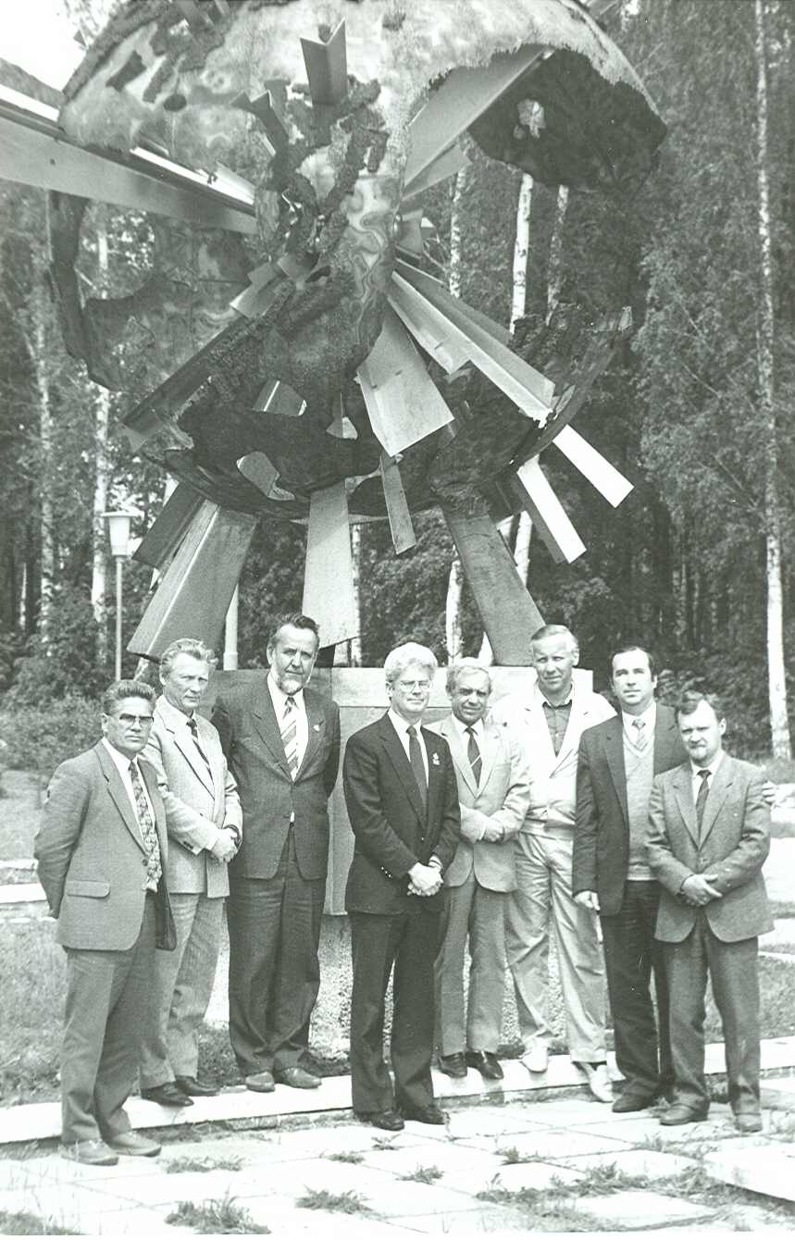
My first visit to RIAR in 1990
Thanks for your attention!
Questions?

Slide 52
Back-up slides

Slide 53
Microstructure of 304L BWR Core Shroud after 25 years, reaching 1.9 dpa at 290ºC
Thomas, Edwards, Asano, Ooki and Bruemmer, 2007.
Fresnel contrast image
<111> Relrod image (Frank loops)

Slide 54
Voids in austenitic pressure vessel of BR-10 developed at very low dpa rate of 1.9 x 10⁻⁹ dpa/sec
Porollo, Konobeev and Garner, 2005
Russian analog of AISI 321
50 nm
100 nm
12Х18Н9Т steel at 0.64 dpa and 350ºC
left-hand - large voids on sub-grain boundaries
right-hand - spatial distribution of smaller voids.

Slide 55
Swelling of
Swelling, %
fast fluence n/cm2, E > 0.1 MeV

