Slide 1
«A.A. Bochvar High-technological science research institute of inorganic materials (JC «VNIINM»)
Structural materials for fast neutron reactors with sodium and lead coolans
M.V. Leontyeva-Smirnova, M.V. Skupov, A.A. Nikitina,
I.A. Naumenko, N.M. Mitrofanova
ХI CONFERENCE ON REACTOR MATERIALS
Dimitrovgrad
May 27 – 30, 2019
.

Slide 2
The aim of works
Development of structural materials (SM) for the modernization of existing and creation of promising active zones of fast neutron reactors with liquid metal coolants (BREST-OD-300, BN-1200, MBIR).

Slide 3
Composition of works on R&D of structural materials
SM
R&D
production setting
Pre-reactor data
(experiment+
modelling)
Out-of pile data:
swelling, physical and mechanical properties, structural transformatios,corrosion, etc
STD
physical properties
industrial development
technological study
mechanical properties
corrosion
structural stability

Slide 4
The main technological areas in the development of SM:
Optimization of metallurgical production, in particular, the use of special charge materials.
The narrowing of the specified intervals of the content of alloying elements.
Reducing the number of non-metallic inclusions.
The use of special methods of processing melts.
Improving the production of all types of metal products, primarily components of fuel rods and fuel assemblies.
The study of the complex properties of materials in the initial state and after irradiation for the strength calculations of fuel rods and fuel assemblies, the creation of models, their verification, as well as certification and certification of materials.

Slide 5
Developments in the field of SM for fuel element cladding for promising fast reactors
Cladding materials for sodium reactors
(MBIR, BN-600, BN-800, BN-1200)
Wrapper material – steel EP450
Cladding materials for
BREST-OD-300
Steel ChS68
t_{max}=700°C;
D_{MAX}=92 dpa
Steel EP823
t_{max}=650°C;
D_{MAX}=150 dpa
EK164
t_{max}=700°C;
D_{MAX}=110 сна
Bimetall and/or steel EP823 with coating
t_{max}=670°C;
D_{MAX}=150 сна
Steels EK181/ChS139
t_{max}=700°C;
D_{MAX}=140 dpa
Prospective materials
ODS steel
Vanadium alloys
t_{max}=710°C;
D_{MAX}≥140 dpa

Slide 6
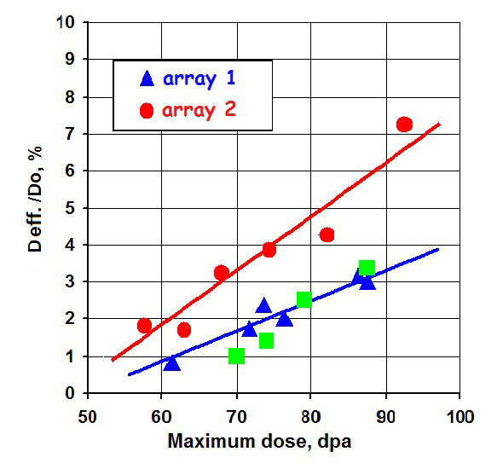
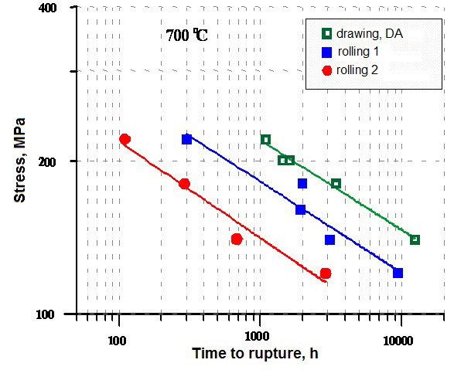
Steel CHS68
To improve the quality of steel pipes CHS68:
- the chemical composition of the steel CHS68 has been optimized and narrowed;
- used the operation of diffusion annealing on a pig pipe;
- the temperature of intermediate austenitizing annealing is increased using a forced heating unit;
- a short adjustment drawing scheme was used to create the final cold-deformed state.

Slide 7
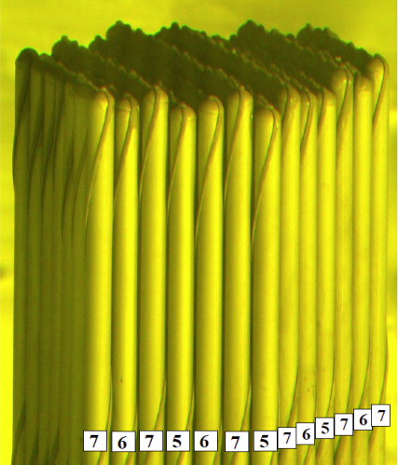
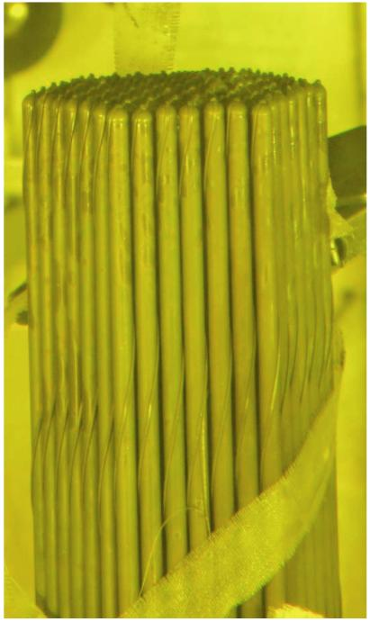
The results of post-reactor studies of reference fuel assemblies with shells of fuel rods from ChS68 reactor BN-600
External view of the end of a bundle of fuel rods of a reference fuel assembly with claddings from steel ChS68,
produced by different technologies
External view of the end of a bundle of fuel rods of a reference fuel assembly with claddings from steel ChS68, irradiated up to 83 dpa
Change in effective diameter of claddings is
• АТОН (1200 С – code 5) - 1,9 %
• АТОН (1140 С- code 6) - 2,3 %
• VSQ (1060 С – code 7) - 3,5 %
The transition from the damaging dose of 75 dpa to 87 dpa was achieved through the work on the improvement of steel ChS68-ID, i.e. without any structural changes to the fuel elements and fuel assemblies or their modes of operation.
Outcome: a reasonable forecast for the use of steel CHS68 to 95 dpa (BN-600, BN-800, MBIR)

Slide 8
Steel EK164
To achieve damaging doses of not less than 110 dpa, steel EK164 was developed. During the development period, the technology of metallurgical and pipe processing was improved and its chemical composition was optimized.
Structural factors in the development of steel EK164:
Solid solution
- Ni content increased, B, P and Ce introduced;
- high-temperature annealing at the metallurgical and pipe stages processing at a temperature of 1180 ÷ 1200 ˚С to increase the content in solid solution of boron and the main alloying elements.
Carbonitdide
- Ti, Nb, V, formation of MC during irradiation
- the formation of phosphides (the introduction of P).
Cold deformation
- creation of a cold-deformed structure using the KOV method for (20 ± 3)%.

Slide 9
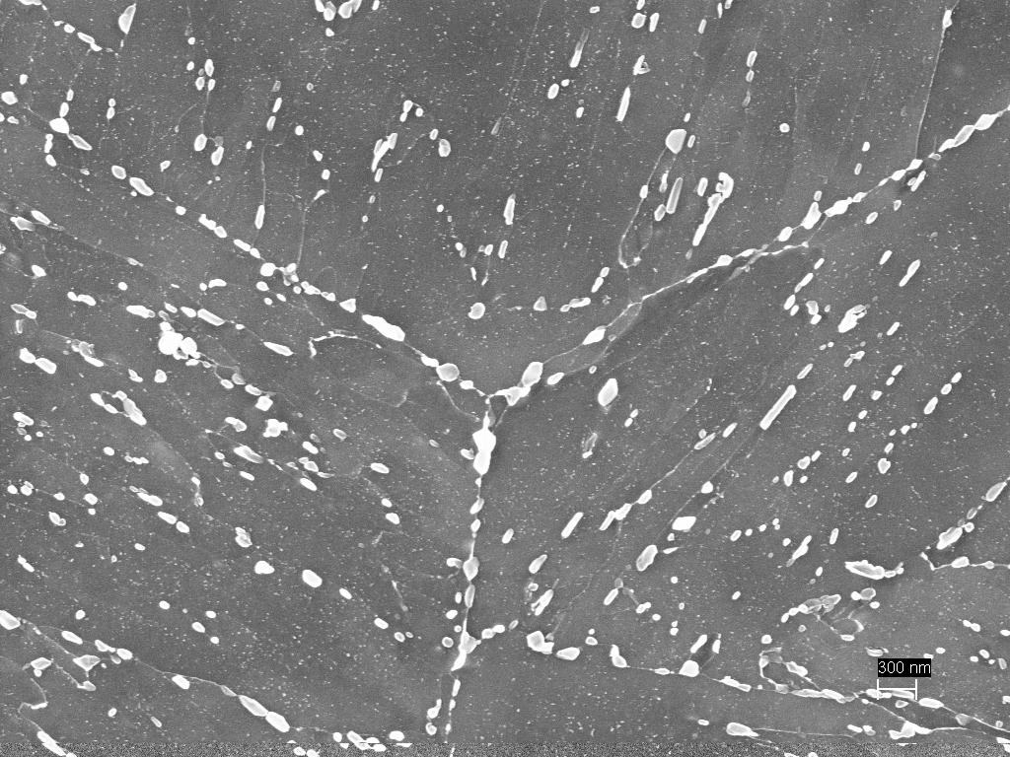
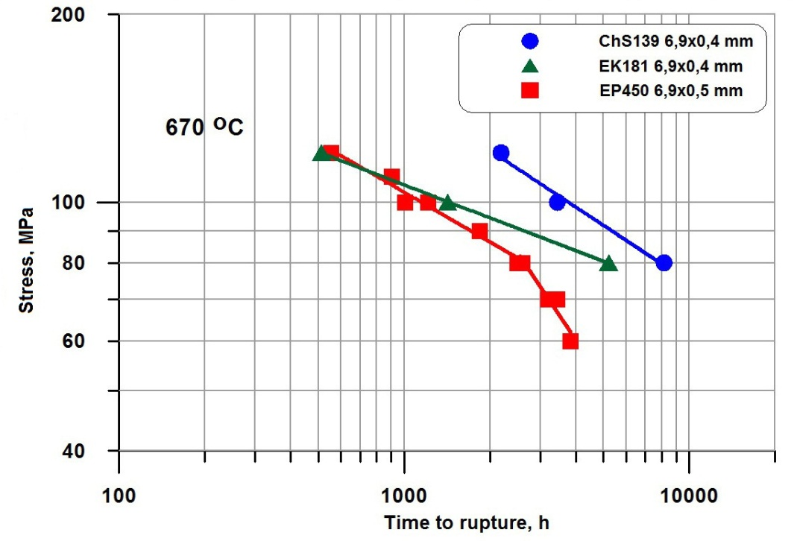
Ferritic-martensitic steels: alloying systems and long-term strength of thin-walled tubes
EP 450: Fe-13Cr-2Mo-Nb-V-B-0,12C
EK181: Fe-12Cr-2W-V-Ta-N-B-0,16C
ChS139: Fe-12Cr-Mo-W-Nb-V-N-B-0,20C
М(C,N)
М₂₃С₆
Carbide phases in the structure of
steel EK181 after quenching and
tempering

Slide 10
Industrial development of ferritic-martensitic steels EK181 and ChS139
In the course of industrial development of steel EK181 and ChS139 the technical conditions for the supply were developed:
tube shell;
cladding tubes (Ø6,9×0,4 mm, Ø9,3×0,6 mm, Ø9,3×0,5 mm и Ø10,5×0,5 mm);
bar with special surface finish for caps;
wire blanks for the manufacture of spacer wire (Ø5,5 mm);
spacer wire ∅1,05 mm and ∅1,3×0,6 mm).
Experimental batches are made:
thin-walled tubes Ø6,9×0,4 mm, Ø9,3×0,6 mm, Ø9,3×0,5 mm (ChS139) and Ø10,5×0,5 mm (ChS139);
bar with special surface finish for caps ∅10 мм;
wire blanks Ø5,5 mm;
spacer wire ∅1,05 mm and ∅1,3×0,6 mm.
To obtain data on the radiation resistance of steels EK181 and ChS139, sample irradiation is planned in the BN-600 material science assemblies (planned parameters: 87, 145 and 169 dpa, Tirrad up to 700 ºС).

Slide 11
Ferritic-martensitic steel EP823
12% chromium ferritic-martensitic steel EP823 with increased
(up to 1.3 wt. %) silicon content, doped with carbide-forming elements W, V, Nb in the range of 0.2-0.8%, Ce 0.1% and В 0.006% is mastered and justified as the material of the shells of fuel elements, and other units of the BREST-OD-300 reactor.
Works are carried out in the following directions:
Technological design.
Studies of the structural phase state and physico-mechanical properties at all stages of the development and manufacture of products.
Research and substantiation of corrosion resistance.
Justification of radiation resistance.

Slide 12
Corrosion, including fretting corrosion, samples of steel EP823 of new technological performance and advanced materials
Corrosion tests were carried out in the lead coolant flow in the CM-2 test bench with the concentration of dissolved oxygen С [O] = (1-4) · 10-6 wt. %, with a duration of ~ 16000 hours at temperatures of 425 - 670 °C.
Results
On all samples (steel EP823 in the initial state and with a modified surface) no corrosion-erosion damage was detected.
The thickness of the oxide film did not exceed 15 μm at each temperature (TT BREST is not more than 50 μm).
Liquid metal corrosion (corrosion by dissolution mechanism) was not detected on any of the investigated samples.
The interaction of the samples with the coolant does not lead to loss of strength properties and embrittlement of the shell material.
The mechanical properties of the samples vary within the limits typical for pipe samples subjected to the usual thermal aging at 650 (670) ° C.
The resistance of model samples with shell pipes made of EP823 steel and bimetallic pipes to fretting corrosion at 620 ° С, ~ 5000 h, С [O] = (1-4) · 10-6 wt. %, coolant velocity ~ 1.6 m / s.
Bench corrosion tests of fuel assembly mockups from EP823 steel in lead with oxygen content higher (̴10-5 wt.%) And below (̴10-7-10-8 wt.%) Were carried out. Conducted materials research.

Slide 13
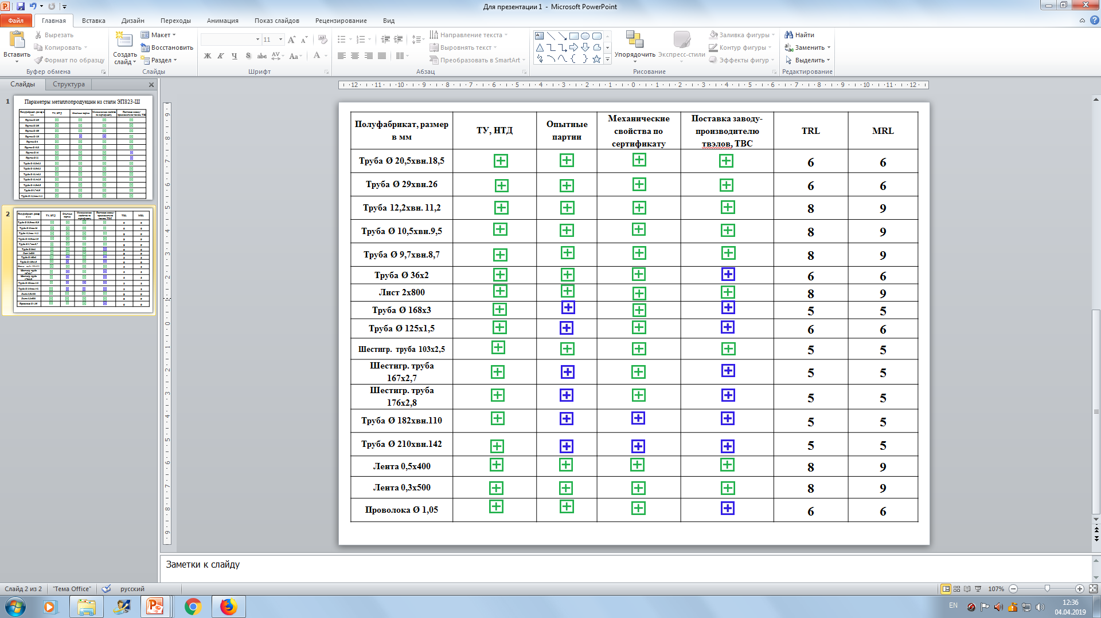


Matrix of parameters of metal products from steel EP823
experimental batches are produced
experimental and industrial batches are produced

Slide 14
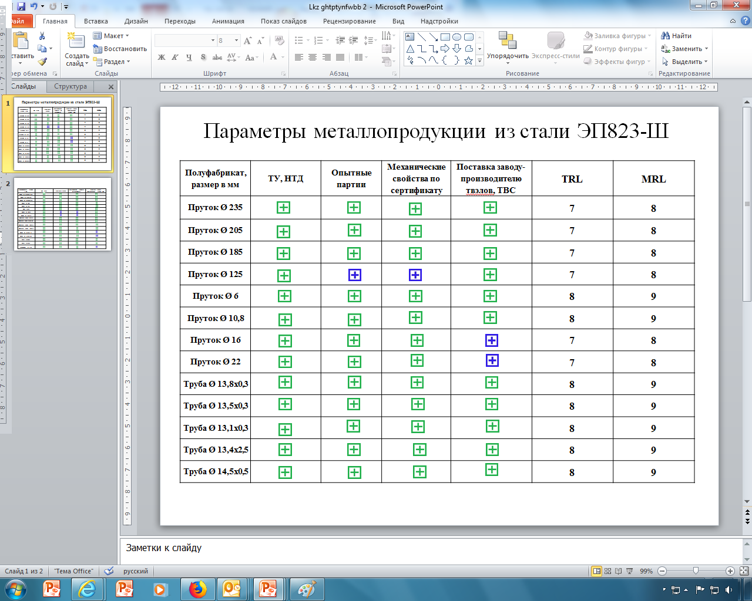
Matrix of parameters of metal products from steel EP823
experimental batches are produced
experimental and industrial batches are produced

Slide 15
Radiation resistance
Radiation resistance of steel EP823 has a satisfactory level, as demonstrated on the samples in the composition of the material assembly BN-600 (Tirrad up to 500ºС, dose 108 dpa), on the hexagon covers of the fuel assembly of the BN-600 reactor (Tirrad up to 600 ºС, dose up to 60 dpa).
The following radiation studies of EP823 steel are focused on tests in the BN-600 reactor of materials science assemblies with a removable container, the use of which ensures the attainment of damaging doses of 140 sleep at constant operating parameters in the temperature range of 400-700 ° C with minimal effect of transients and heat pumps.

Slide 16
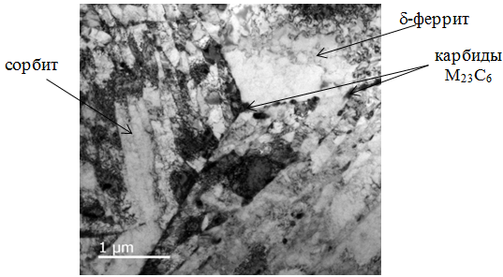
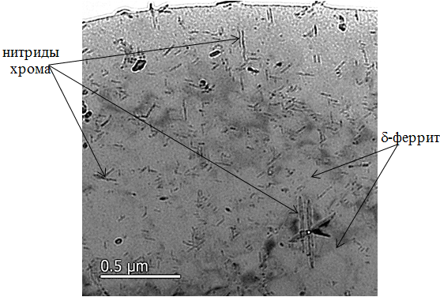
Steel EP900
EP900 steel is a heat-resistant modification of EP823 steel; it is characterized by a high (̴ 0.14 wt.%) nitrogen content.
Microstructure of
tubes 6,9×0,5 mm
from steel EP900
In initial state
It has increased structural stability and stability of mechanical properties during thermal aging in the temperature range (450-670) ºС due to the presence of dispersed particles of chromium nitrides in the structure.
The values of long-term strength of steel EP900 at a temperature of 650 ºС on the basis of 10,000 hours exceed the values for EP823 by about 20%.

Slide 17
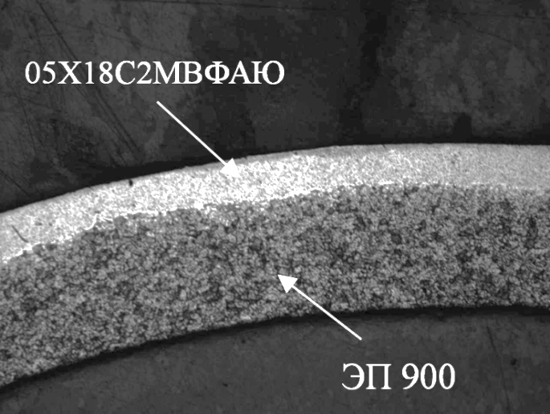
Bimetallic tubes
Experimental batches of bimetallic tubes 9.7 × 0.5 mm size with different ratios of layers of Fe-18Cr-2Si and EP900 steels were made in JSC VNIINM. It is established that the optimal ratio of layers in the complex of properties is 1: 3
The value of the tensile strength of bimetallic pipes is about 20% higher compared to EP823 steel.
Conducted corrosion tests of bimetallic tubes in a dynamic stand with lead coolant for 1000 hours at an oxygen concentration in lead С [O] = (1-4) · 10-6% mass. and a temperature of 650 ° C showed that a dense protective oxide film is formed on the samples due to the high content of silicon and aluminum alloying of ferritic steel.
Micrograph of bimetallic tube

Slide 18
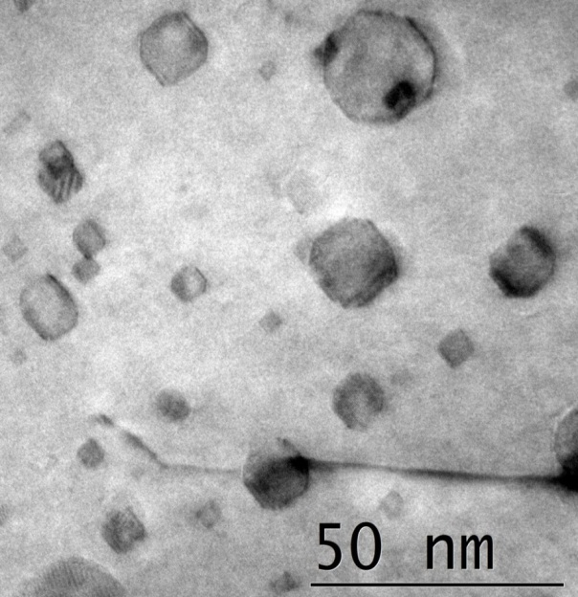
ODS steels
Creep curves of flat samples of steel EP450 ODS
In structure of steel EP450 ODS
the double yttrium-titanium oxides
with size (5-200) mm and concentration
5x10¹⁵ cm⁻³ are presented
Т_{test.} = 700 °С: 1 - σ = 100 МPа; 2 - σ = 140 МPа;
Т_{test.} = 650 °С: 3 - σ = 100 МMа; 4 - σ = 140 МPа.
Steel EP450 ODS can withstand without failure under a load of 100 MPa at 700 ° C more than 44,000 h (tests continue).

Slide 19
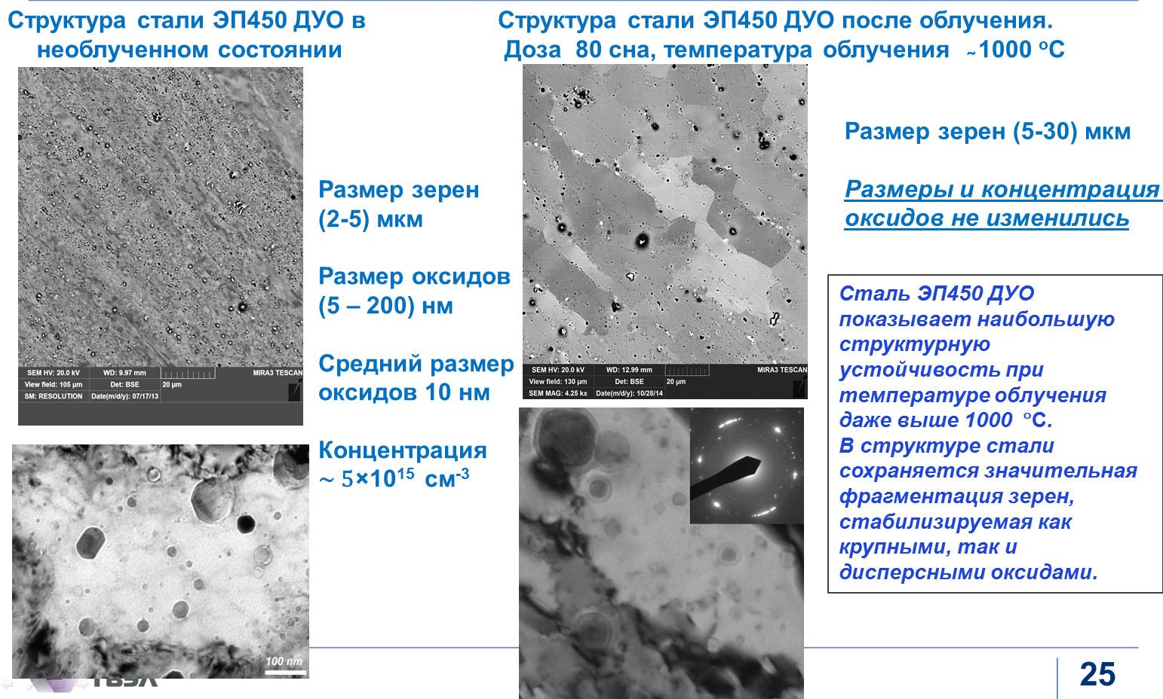
The effect of irradiation in the BN-600 reactor on the microstructure
of steel EP450 ODS
Structure of steel EP450 ODS in non-irradiated condition
Structure of steel EP450 ODS after irradiation
Dose 80 dpa, irradiation temperature ̴1000 °C
Grain size
(5-30) mkm
Grain size
(2-5) mkm
Size and concentration of oxides did not change
Oxide size
(5-200) nm
Steel EP450 ODS shows most stable structure at irradiation temperatures even higher than 1000 °C due to the disperse oxides
Mean oxide size 10 nm
Concentration
5x10¹⁵ cm⁻³

Slide 20
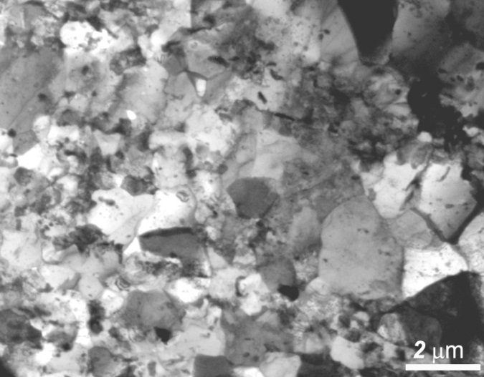
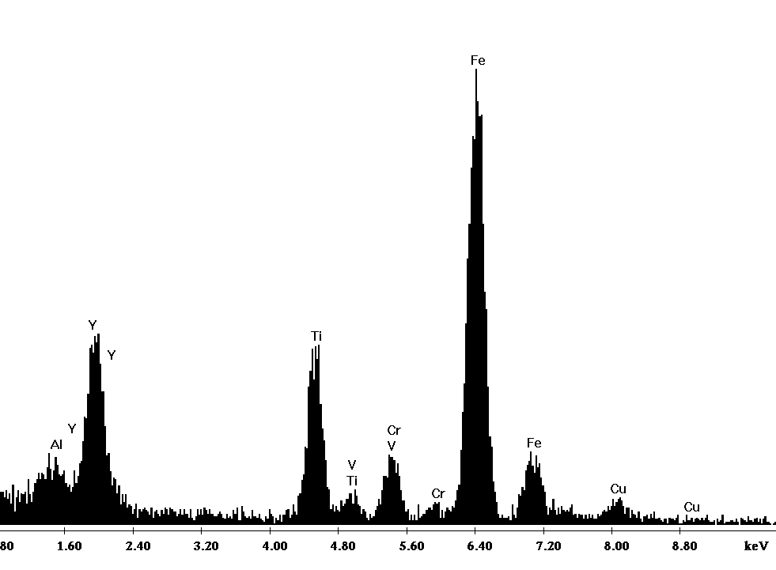
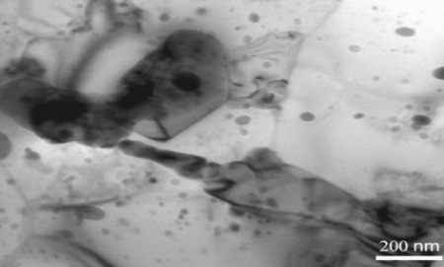
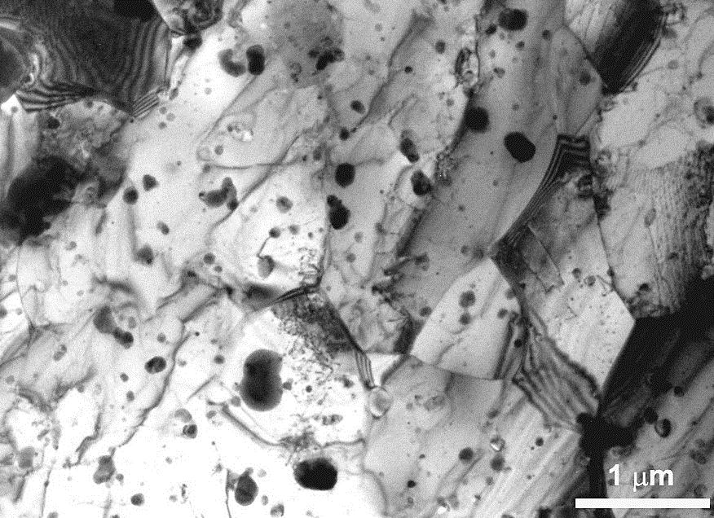
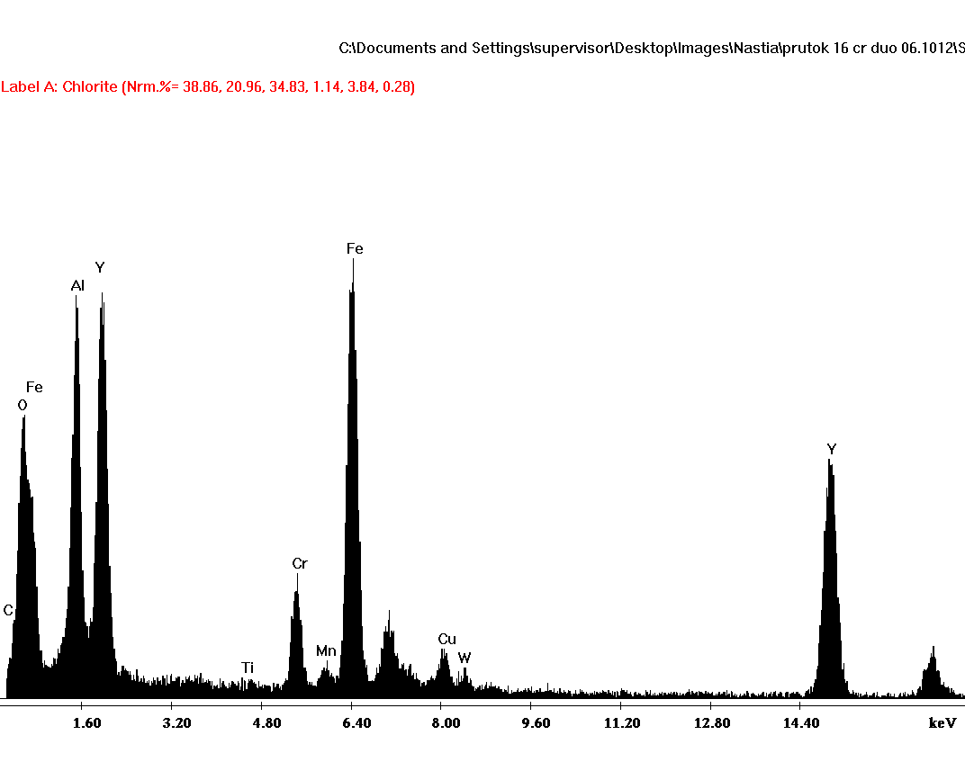
ODS steels being developed for use as fuel claddings of a lead-cooled reactor
Steel EP823 ODS
Mean oxide
size 20 nm;
Concentration
~ 2×10¹⁵ cm⁻³
Steel Fe-16Cr-4Al-2W-Si-Ti ODS
Mean oxide Concentration
size 40 nm ~ 10¹⁵ см⁻³

Slide 21
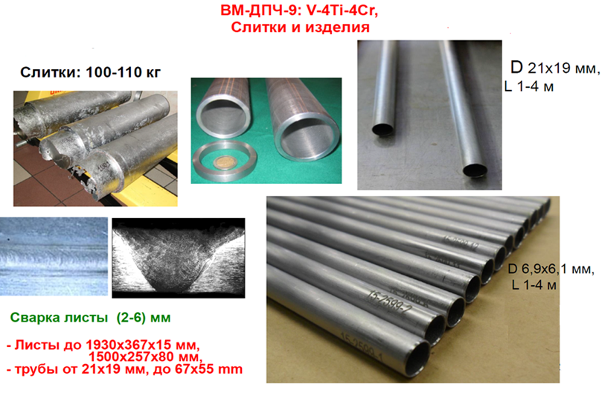
Vanadium alloys

Slide 22
Conclusion
The main thematic areas and results of work on the development and study of structural materials for the cores of fast neutron reactors with sodium and lead and coolants are presented.
For reactors with a liquid metal coolant, the key task is to create radiation-resistant and heat-resistant shell materials, ensuring the achievement of damaging doses of at least 140 sleep.
The main material for fuel element claddings and fuel elements of the BREST-OD-300 reactor is EP823 ferritic-martensitic steel with a high silicon content.
EP900 steel, bimetallic tubes and ODS steel are considered as materials designed for increased burnout of nitride fuel (over 6% h.a.). For all materials, work is carried out to substantiate their radiation resistance.

Slide 23
Conclusion
The experience of researching, introducing and operating steel CHS68 provides a solution for rectors with sodium coolant due to the phased use of a new generation of EK164 austenitic steel shells, dispersion-hardening heat-resistant ferritic-martensitic steels EK181 and ChS139 (maximum damaging dose ~ 140 dpa) as shells and oxides dispersion-strengthened (ODS) steels (maximum damaging dose of more than 140 sleep).
Vanadium alloys are promising materials for active zones with different types of coolant, designed for elevated parameters in terms of temperature and radiation dose.
Work is underway on the technological development and study of the radiation resistance of all materials.

