Slide 1

Swelling, creep and embrittlement of D9 stainless steel cladding and duct irradiated in four FFTF mixed-oxide driver fuel assemblies after high neutron exposures
F. A. Garner
Moscow Engineering Physics Institute
Department of Materials Science

Slide 2
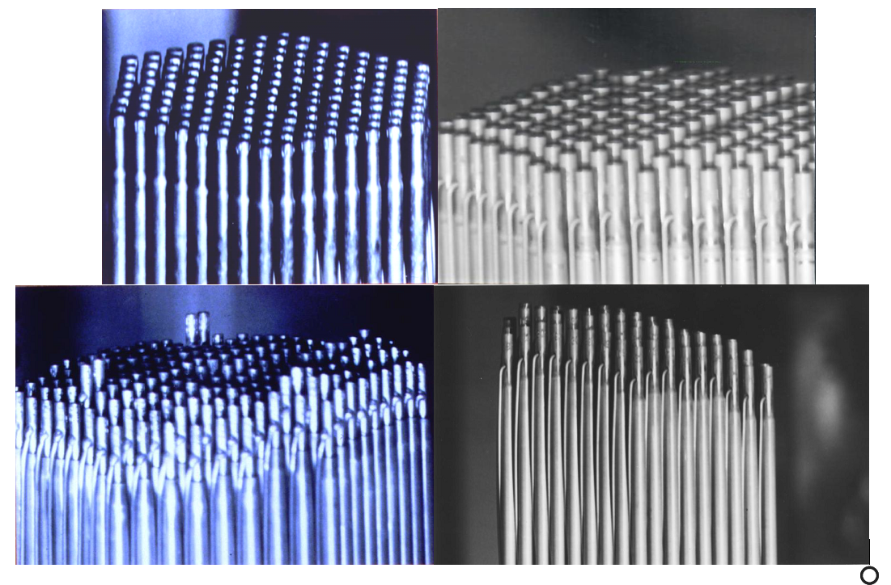
Upper surface of D-9 assemblies after irradiation
As-fabricated
C-1
D9-2
D9-4

Slide 3
Background on D9-clad fuel assemblies
D9 was the improved swelling-resistant variant of 316 stainless steel developed for fast reactor application as driver fuel in the USA.
Most of the data in this report was generated in 1991-1993 after several years of irradiation in the FFTF fast reactor.
Some brief summary reports were published by B.J. Makenas, J.W. Hales, S.A. Chastain, B.C. Gneiting, A.L. Pitner, B.C. Gneiting, F.E. Bard.
FFTF was decommissioned and the fast reactor program was terminated.
Very little analysis of the D9 data was conducted before the program was terminated.
Three decades later I am compiling a detailed report on the cladding and duct, but not on the fuel.
I will provide only some highlights in this presentation.
The publication will be submitted to J. Nuclear Materials in 3-4 months.

Slide 4
Background on D9-clad fuel assemblies
D9 was the improved swelling-resistant variant of 316 stainless steel developed for fast reactor application as driver fuel in the USA.
Most of the data in this report was generated in 1991-1993 after several years of irradiation in the FFTF fast reactor.
Some brief summary reports were published by B.J. Makenas, J.W. Hales, S.A. Chastain, B.C. Gneiting, A.L. Pitner, B.C. Gneiting, F.E. Bard.
FFTF was decommissioned and the fast reactor program was terminated.
Very little analysis of the D9 data was conducted before the program was terminated.
Three decades later I am compiling a detailed report on the cladding and duct, but not on the fuel.
I will provide only some highlights in this presentation.
The publication will be submitted to J. Nuclear Materials in 3-4 months.

Slide 5
Background on D9-clad fuel assemblies
D9 was the improved swelling-resistant variant of 316 stainless steel developed for fast reactor application as driver fuel in the USA.
Most of the data in this report was generated in 1991-1993 after several years of irradiation in the FFTF fast reactor.
Some brief summary reports were published by B.J. Makenas, J.W. Hales, S.A. Chastain, B.C. Gneiting, A.L. Pitner, B.C. Gneiting, F.E. Bard.
FFTF was decommissioned and the fast reactor program was terminated.
Very little analysis of the D9 data was conducted before the program was terminated.
Three decades later I am compiling a detailed report on the cladding and duct, but not on the fuel.
I will provide only some highlights in this presentation.
The publication will be submitted to J. Nuclear Materials in 3-4 months.

Slide 6
Some construction details
217 wire-wrapped mixed-oxide fuel pins contained in a hexagonal duct.
Cladding, wire wrap, fuel pin end-caps and duct were constructed from two D9 heats in the 20% cold-worked condition.
The ducts were hexagonal in shape, 11.62 cm across a flat, 3.6 m long and 3.05 mm in thickness.
The fuel pin cladding tubes were 5.08 and 5.84 mm inside and outside diameter, respectively, and 2.38 m in length.

Slide 7
Composition of two heats of D9 in wt%
D9-C1 (standard levels of minor and “tramp” elements)
D9-C1P (lower levels of “tramp” elements)
 | Cr | Ni | Mo | Mn | Ti | Si | Cu | V
D9-C1 | 13.78 | 15.15 | 1.46 | 1.74 | 0.23 | 0.92 | 0.02 | 0.03
D9-C1P | 13.36 | 15.55 | 1.62 | 1.85 | 0.28 | 0.85 | <0.01 | <0.01
 | C | P | N | B |  | The C1P heat also has lower levels of Nb, Ta, Al, As, Co and a slightly higher level of S.
D9-C1 | 0.052 | 0.009 | 0.005 | 0.001
D9-C1P | 0.045 | 0.002 | 0.002 | <0.005
Specification P< 0.04 wt%

Slide 8
Six prototypic fuel assemblies were irradiated in FFTF, but only four assemblies were destructively examined

Slide 9
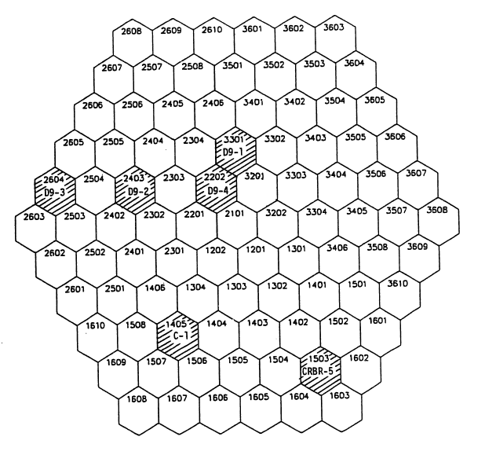
Six D9-clad, mixed-oxide-fueled assemblies were irradiated in FFTF
Six D9 assemblies were irradiated in various positions (Rows 2 through 6) in FFTF.
Two assemblies were moved during the irradiation campaign.
Four of these assemblies explored a range of temperature histories.

Slide 10
Each of the four assemblies explored a different temperature history
Coolant outlet temperature histories (top of the fuel column) for typical high temperature pins.
Note the large increase in temperature of C-1 after completing two cycles when moved from Row 4 to Row 2.

Slide 11
Upper surface of D-9 assemblies after irradiation
As-fabricated
C-1
D9-2
D9-4

Slide 12
Major questions addressed in this presentation
For well-specified production heats of steel, is void swelling a reproducible process for a given set of irradiation conditions?
If I see “scatter” in my swelling data, is it due to an inherent chaotic nature of swelling, ….. or does it arise from small variations in temperature, neutron flux or stress?
What are various consequences of swelling on the performance of the fuel assemblies?

Slide 13
All swelling data were derived from density change measurements.
Data are identified by a symbol specific to each assembly.
Is there a possibility to separate the “apparent” scatter into information concerning temperature history and dpa rate?
Is swelling at a given set of irradiation conditions very reproducible ……. or is there inherent chaotic swelling, leading to significant scatter?

Slide 14
Cutting of 1.3 cm long rings and immersion density to assess the reproducibility of swelling
D9-1 assembly
Two adjacent fuel pins clad with D9-C1 heat
D9-2 assembly
Two near-adjacent fuel pins clad with D9-C1 heat
D9-4 assembly
1) Hexagonal duct (2 faces) made from D9-C1 heat
2) Two adjacent fuel pins clad with different heats
D9-C1 (standard levels of minor and “tramp” elements)
D9-C1P (lower levels of “tramp” elements)
All other pins in these four assemblies were examined non-destructively using profilometry and length change.

Slide 15
Fast neutron fluence (E > 0.1 MeV) experienced by two D9 assemblies in FFTF
D9-2 cladding
D9-2 assembly spent more time in reactor and reached a higher fluence level than D9-4.
Each set of two pins experienced near-identical fluxes and temperatures.
Fluences and temperatures of the two duct faces are the same.
D9-4 cladding
D9-4 duct

Slide 16
Time-averaged mid-wall temperatures experienced by two D9 assemblies in FFTF
D9-2 cladding
D9-4 cladding
The D9-4 assembly operated at higher temperatures than did D9-2.
The D9-4 duct operated at lower temperatures than D9-4 cladding.
D9-4 duct

Slide 17
Time-averaged mid-wall temperatures experienced by two D9 assemblies in FFTF
Note very small difference
D9-2 cladding
D9-4 cladding
The D9-4 assembly operated at higher temperatures than did D9-2.
The D9-4 duct operated at lower temperatures than D9-4 cladding.
Temperature and neutron flux are the most important variables to determine the duration of the transient swelling regime.
D9-4 duct

Slide 18
Swelling measured using density change for cladding and duct in two D9 assemblies
D9-2 cladding
D9-4 cladding
D9-4 duct

Slide 19
Swelling measured using density change for cladding and duct in two D9 assemblies
Result of the small difference in temperature or the small difference in phosphorous?
D9-2 cladding
D9-C1P
D9-4 cladding
D9-C1
D9-4 duct

Slide 20
Influence of phosphorous on void swelling in EBR-II
Effect of P on swelling of annealed Fe-25Ni-15Cr
Garner and Kumar, 1987
Effect of P on swelling of Fe-16.2Cr-13.8Ni-2.5Mo-2.0Mn-1.5Si-0.2Ti-0.04C
Garner and Mitchell, 1992

Slide 21
Influence of phosphorous on void swelling in EBR-II
Specification of maximum phosphorous in D9 is 0.04 wt%
Effect of P on swelling of annealed Fe-25Ni-15Cr
Garner and Kumar, 1987
Effect of P on swelling of Fe-16.2Cr-13.8Ni-2.5Mo-2.0Mn-1.5Si-0.2Ti-0.04C
Garner and Mitchell, 1992

Slide 22
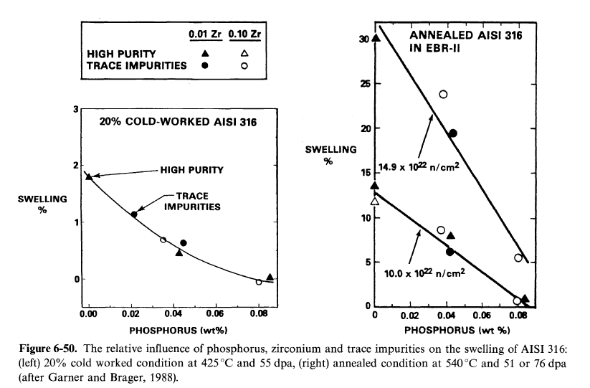
Influence of phosphorous on void swelling of 316 SS in EBR-II Garner and Mitchell, 1992
With respect to the action of all trace impurities, phosphorous is the most important!

Slide 23
Irradiation conditions of D9 fueled assemblies
Assembly name | Location in FFTF | Maximum exposure 10²² n/cm² (E>0.1 MeV) | Maximum dpa
D9-4 | Row 2 | 21.4 | ~92
D9-2 | Row 4 | 25.3 | ~110
No radial gradient
Radial flux gradient
~4.3 dpa per 10²² n/cm² (E > 0.1 MeV)

Slide 24
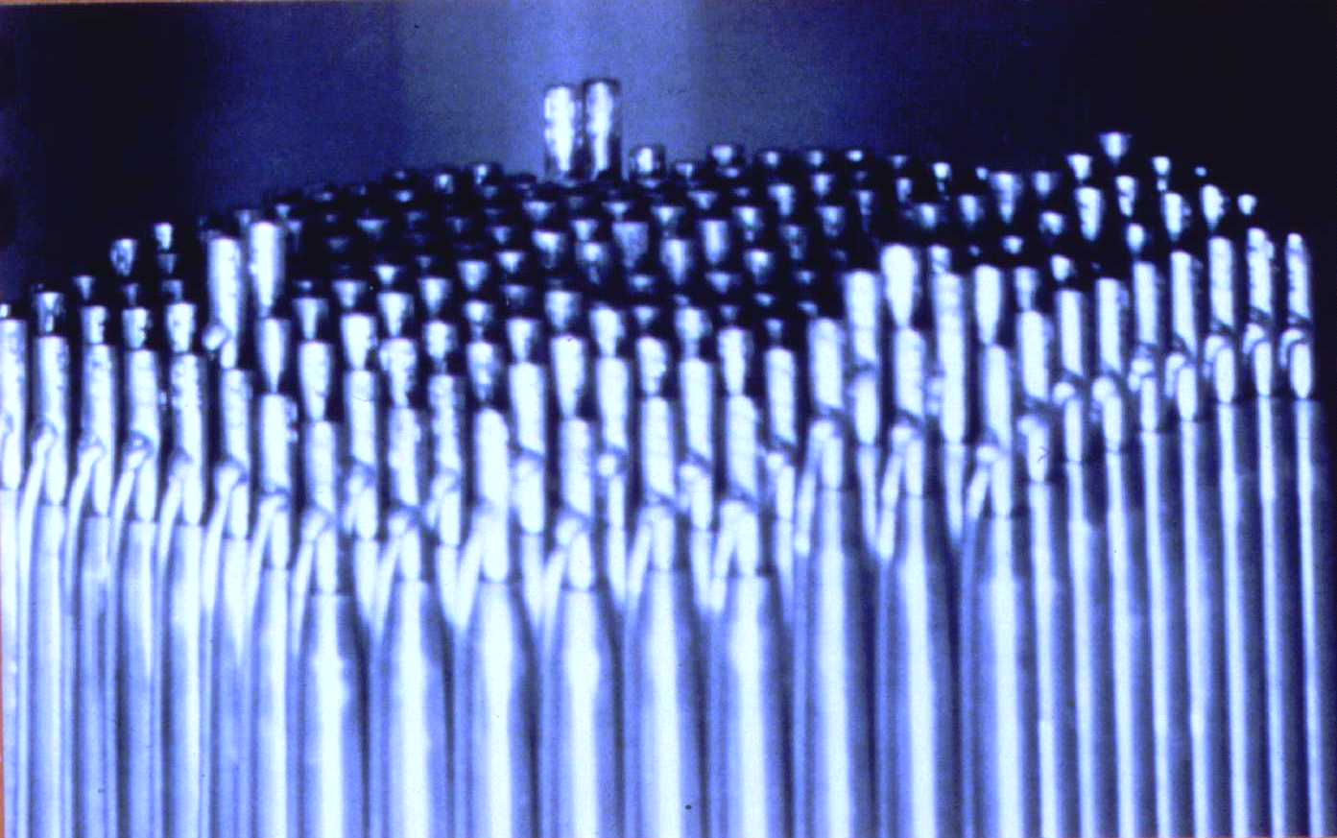
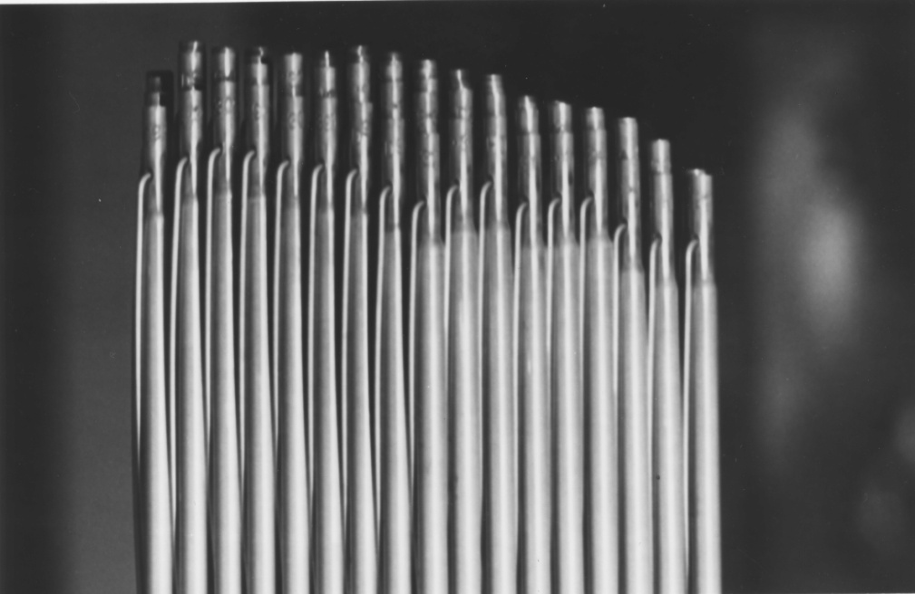
Top of two D9 assemblies showing variable length increases in fuel pins
217 pin assemblies
D9-4 assembly in Row 2 showing increased length change due to higher swelling of D9-C1P pins compared to D9-C1 pins
Difference is due primarily to the lower phosphorous level in D9-C1P.
D9-2 assembly in Row 4 showing higher swelling and length change of D9-C1 pins located closer to the core center
Difference is due primarily to the flux gradient across the assembly.

Slide 25
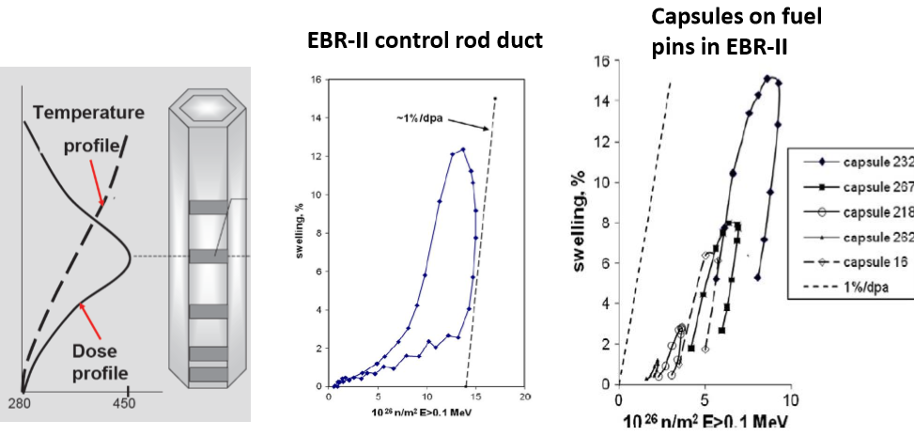
Remember the loop analysis technique shown in yesterday’s plenary lecture?

Slide 26
Swelling of annealed 304 stainless steel cladding in three fuel assemblies in in EBR-II
Garner, Makenas, Chastain, 2011
Row 3 low power Row 4 medium power Row 5 high power
% swelling
1%/dpa
Fluence, 10²⁶ n/m² E>0.1 MeV
Swelling loops become thinner as the temperature range increases.
Skinny loops can be so thin as to be a single line!

Slide 27
Swelling of annealed 304 stainless steel cladding in three fuel assemblies in in EBR-II
Garner, Makenas, Chastain, 2011
Row 3 low power Row 4 medium power Row 5 high power
% swelling
1%/dpa
Fluence, 10²⁶ n/m² E>0.1 MeV
Swelling loops become thinner as the temperature range increases.
Skinny loops can be so thin as to be a single line!

Slide 28
Swelling behavior of heat D9-C1 cladding in the two assemblies: another way to visualize the data
swelling forms “loops” when plotted vs. dpa
Higher fluence in D9-2 leads to higher overall swelling.
Higher temperatures in D9-4 lead to “narrower” loops.
High temperature “wall” defines shortest transient.
Loop and wall behavior is consistent with many other studies.
D9-2
~1%/dpa
D9-4

Slide 29
Swelling behavior of heat D9-C1 cladding in the two assemblies: another way to visualize the data
Very reproducible swelling of two pins.
swelling forms “loops” when plotted vs. dpa
Higher fluence in D9-2 leads to higher overall swelling.
Higher temperatures in D9-4 lead to “narrower” loops.
High temperature “wall” defines shortest transient.
Loop and wall behavior is consistent with many other studies.
D9-2
~1%/dpa
D9-4

Slide 30
Swelling behavior of heat D9-C1 cladding in the two assemblies: another way to visualize the data
swelling forms “loops” when plotted vs. dpa
Higher fluence in D9-2 leads to higher overall swelling.
Higher temperatures in D9-4 lead to “narrower” loops.
High temperature “wall” defines shortest transient.
Loop and wall behavior is consistent with many other studies.
All temperatures between ~420 and ~540°C lie in the 1%/dpa regime …. and maybe even beyond.
D9-2
~1%/dpa
D9-4

Slide 31
Comparison of swelling in D9-C1 cladding and duct in D9-4 assembly
cladding
Neutron fluences of cladding and duct are nearly identical.
Lower swelling of duct faces compared to cladding is related primarily to their lower temperature.
duct

Slide 32
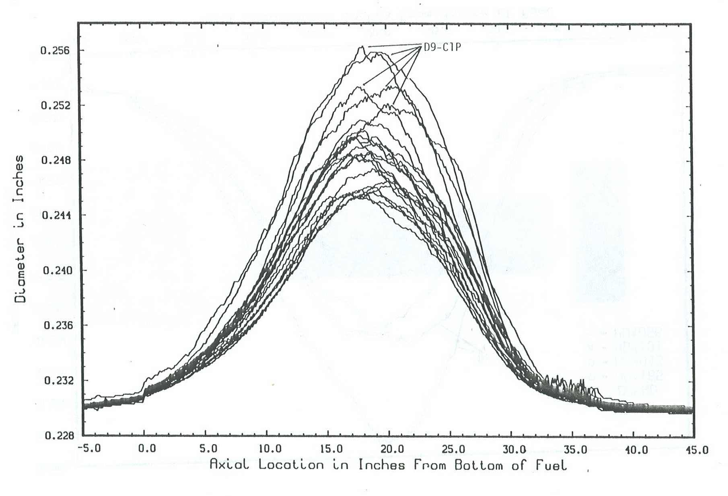
In assembly D9-4 the pins with D9-C1P cladding swell and creep more than pins with D9-C1
Group of interior pins with similar irradiation conditions
D9-C1P
Profilometry data

Slide 33
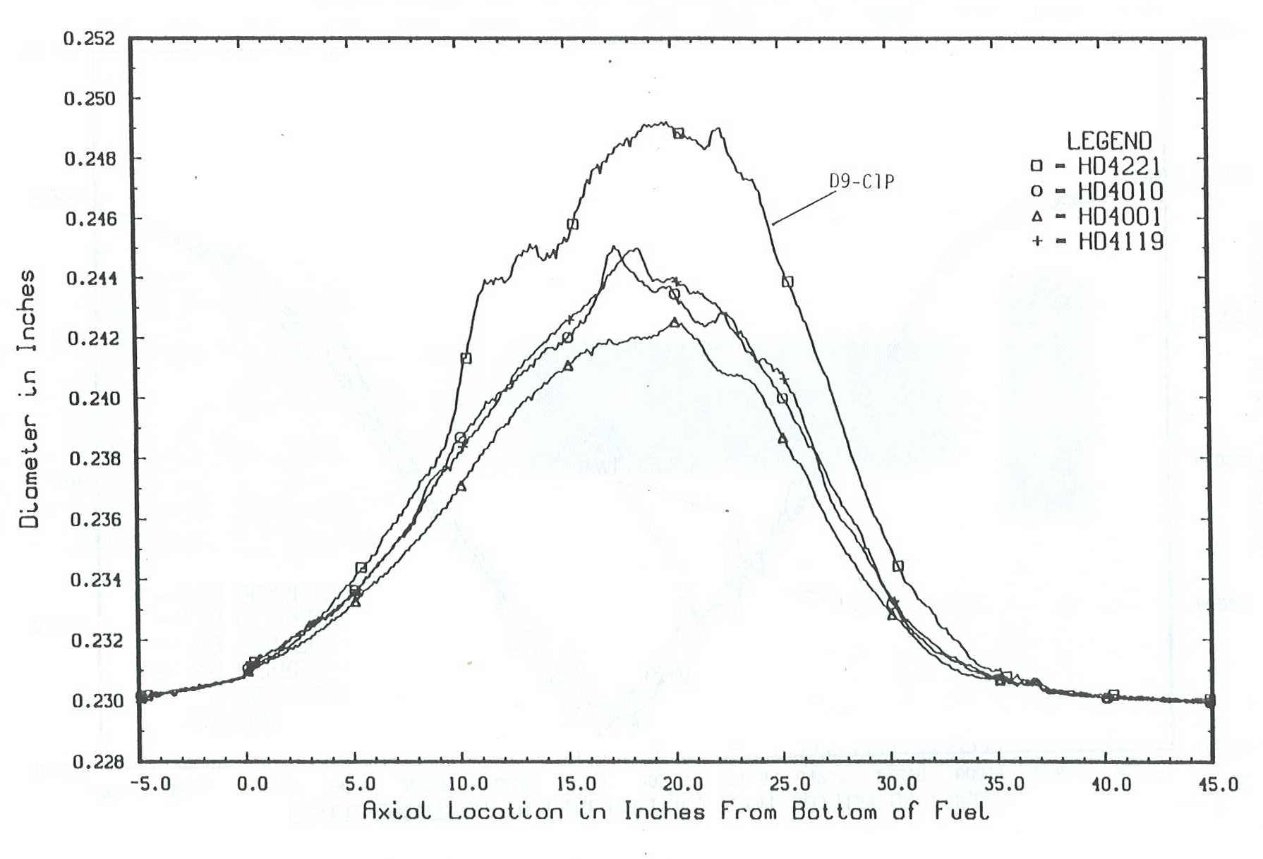
In assembly D9-4 the pins with D9-C1P cladding swell and creep more than pins with D9-C1
Group of corner pins with similar irradiation conditions
D9-C1P
Profilometry data

Slide 34
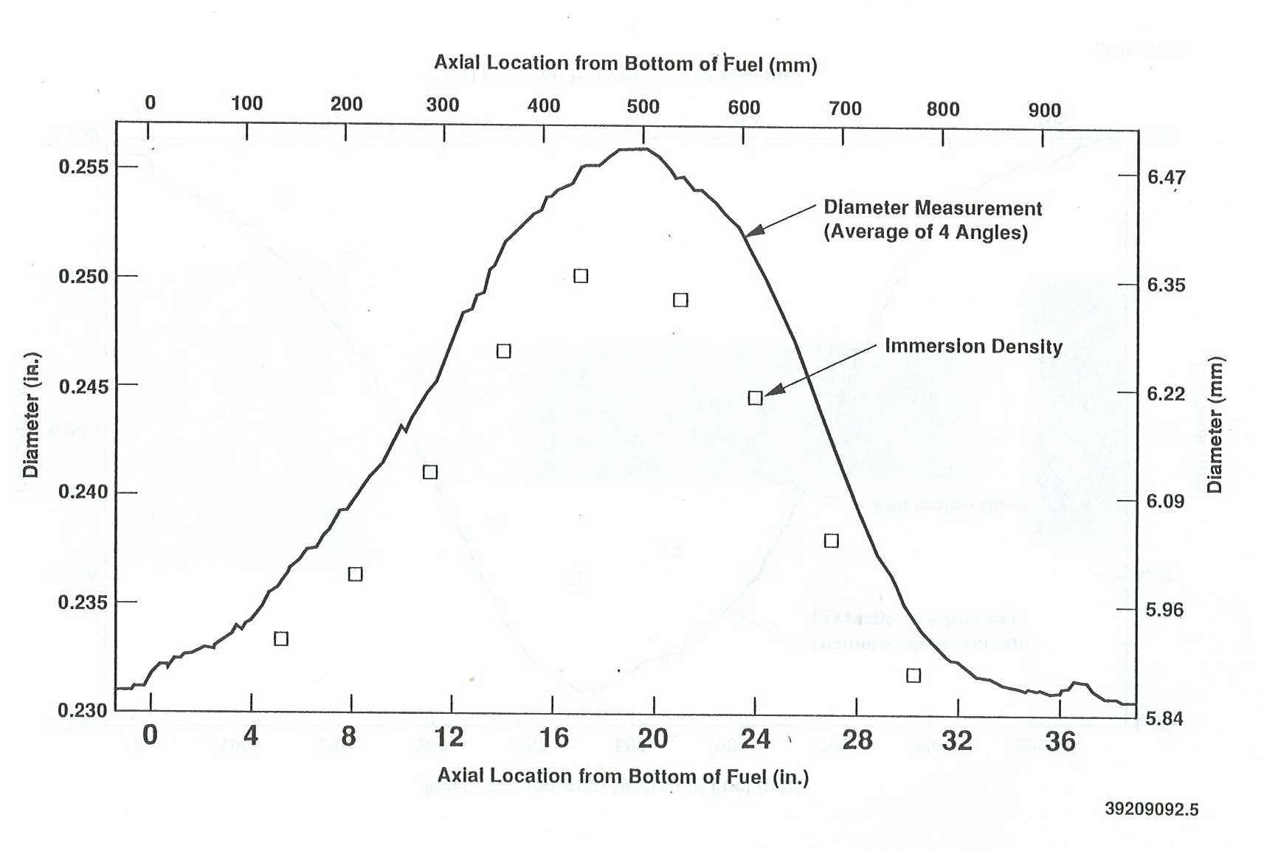
Most radial deformation arises from swelling and not creep
Pin 4161 from D9-4
D9-C1 Heat
All pins exhibited this behavior.

Slide 35
Most radial deformation arises from swelling and not creep
Pin 4161 from D9-4
D9-C1 Heat
“Swelling before creep” case
Fission gas builds up slowly.
Creep disappearance phenomena
All pins exhibited this behavior.

Slide 36
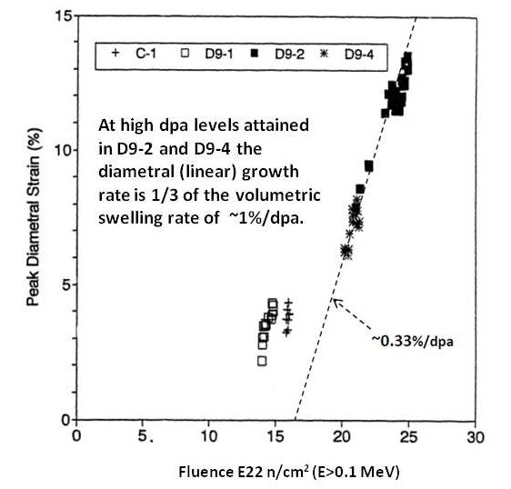
Do the high fluence assemblies obey the 0.33%/dpa strain rate criteria?
Yes, D9-2 and D9-4 obeyed this criteria for every examined pin.
C-1 and D9-1 may obey with a smaller incubation period but the data are insufficient to state with confidence.

Slide 37
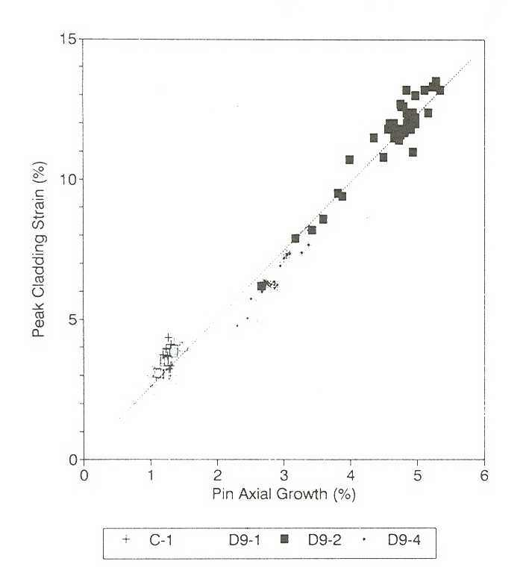
Correlation between peak cladding diametral strain and axial growth
Length-averaged swelling leads to increase in pin length.
Length increase contains no creep contribution.
Length grows at ~40% the rate of peak radial strain.
Differences in composition, dpa rate and temperature do not affect this relationship!

Slide 38
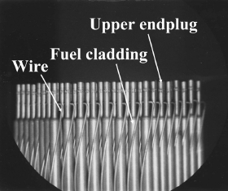
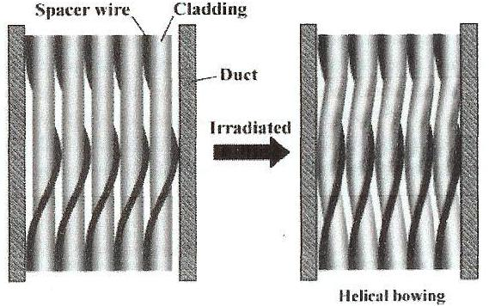
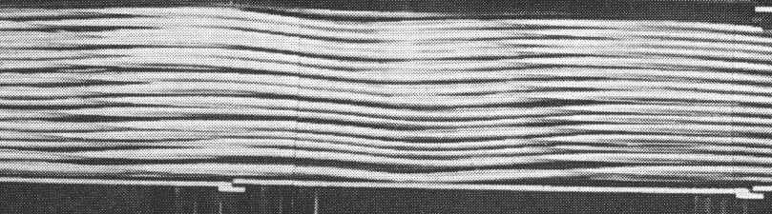
Swelling behavior of FFTF fuel pins under constrained condition by wire wrap
In presence of constraint the swelling strain is directed by irradiation creep toward unconstrained directions.
Constraints can be externally applied or arise internally from gradients in swelling.
Stresses generated by swelling or swelling gradients will never exceed the yield stress.
~40% maximum swelling in D9-2

Slide 39
Swelling-creep interaction of clad with wire wrap to produce spiral pins in FFTF
D9-2 assembly
No pin failures were observed even for such large deformation.

Slide 40
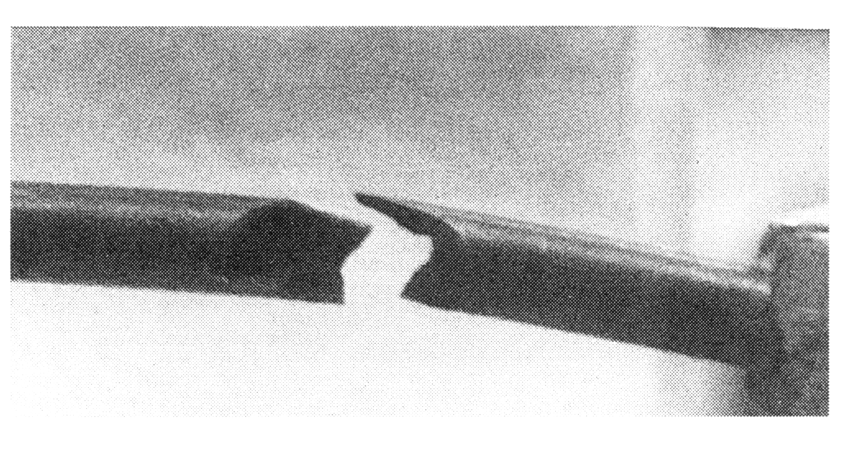
Out-of-reactor failure of D9-2 fuel pin after irradiation in FFTF to ~110 dpa
Makenas et al., 1990
The life-limiting factor for FFTF fuel pins was swelling-induced embrittlement, not fuel burn-up.
Two fuel pins were broken upon receiving minor physical insults from the manipulator. There was ~30% swelling at the failure points.

Slide 41
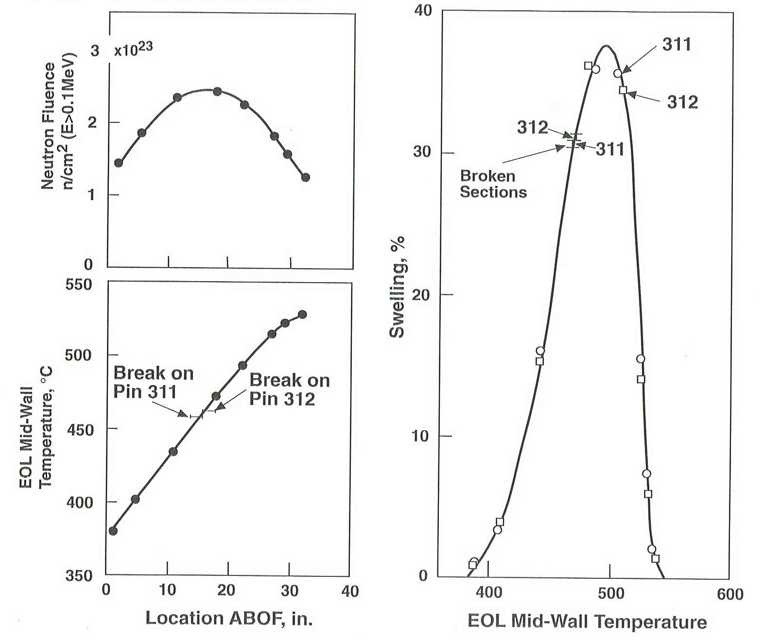
Void-induced embrittlement of two sibling fuel pins in D9-2 assembly
Different physical insult to produce failure in each pin
Failure occurred at the same position and swelling level.
The D9-2 duct also showed evidence of cracking during production of test specimens.

Slide 42
Conclusions
Minor variability in composition of D9 leads to significant differences in swelling behavior.
Small variations in phosphorus are especially important.
It is necessary to define both upper and lower limits of composition specifications for uniformity of response.
For a well-specified production heat swelling is very reproducible at a given set of irradiation conditions.
Most “scatter” is information that you do not recognize.
Post-transient swelling rate is ~1%/dpa over a wide range of temperatures, at least 420 to 540°C ….. probably even over a larger range.
High swelling leads to large axial growth of pins and development of spiral ovality.
While high swelling does not lead to direct in-reactor failures, post-irradiation examination shows severe void-induced embrittlement during examination.

Slide 43
Conclusions
Minor variability in composition of D9 leads to significant differences in swelling behavior.
Small variations in phosphorus are especially important.
It is necessary to define both upper and lower limits of composition specifications for uniformity of response.
For a well-specified production heat swelling is very reproducible at a given set of irradiation conditions.
Most “scatter” is information that you do not recognize.
Post-transient swelling rate is ~1%/dpa over a wide range of temperatures, at least 420 to 540°C ….. probably even over a larger range.
High swelling leads to large axial growth of pins and development of spiral ovality.
While high swelling does not lead to direct in-reactor failures, post-irradiation examination shows severe void-induced embrittlement during examination.

Slide 44
Conclusions
Minor variability in composition of D9 leads to significant differences in swelling behavior.
Small variations in phosphorus are especially important.
It is necessary to define both upper and lower limits of composition specifications for uniformity of response.
For a well-specified production heat swelling is very reproducible at a given set of irradiation conditions.
Most “scatter” is information that you do not recognize.
Post-transient swelling rate is ~1%/dpa over a wide range of temperatures, at least 420 to 540°C ….. probably even over a larger range.
High swelling leads to large axial growth of pins and development of spiral ovality.
While high swelling does not lead to direct in-reactor failures, post-irradiation examination shows severe void-induced embrittlement during examination.

Slide 45
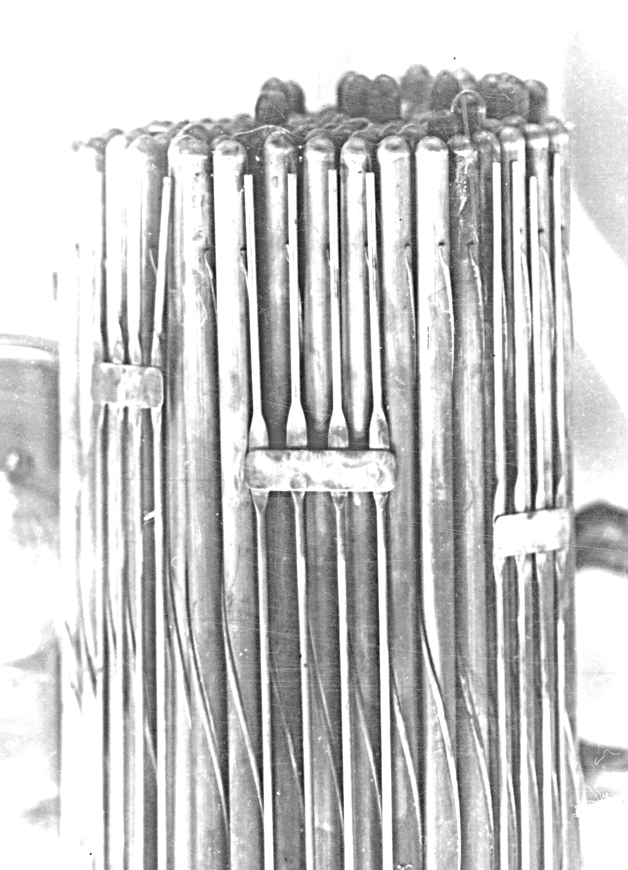
Top end of fuel pin bundle in BN-600 with annealed EI-847 cladding
Porollo, Shulepin, Konobeev, Garner, 2008
Two heats of fuel pins
Both heats fell within specifications.
C(0.04-0.06); Mn(0.4-0.8); Si≤0.4; S≤0.010; P≤0.015; Cr(15.0-16.0); Ni(15.0-16.0); Mo(2.7- 3.2); Nb≤0.9; N≤0.025; B≤0.001; Co≤0.02; Cu≤0.05; Bi≤0.01; Pb≤0.001; Ti≤0.05, wt. %
Heat #1 was measured to be 0.10 ±0.015 wt. % Si and heat #2 had 0.18 ±0.011 wt% Si.
Lower silicon leads to increased swelling.

Slide 46
Top end of fuel pin bundle in BN-600 with annealed EI-847 cladding
Porollo, Shulepin, Konobeev, Garner, 2008
Garner and Kumar, 1987
Effect of silicon on swelling of annealed Fe-25Ni-15Cr irradiated in EBR-II

Slide 47
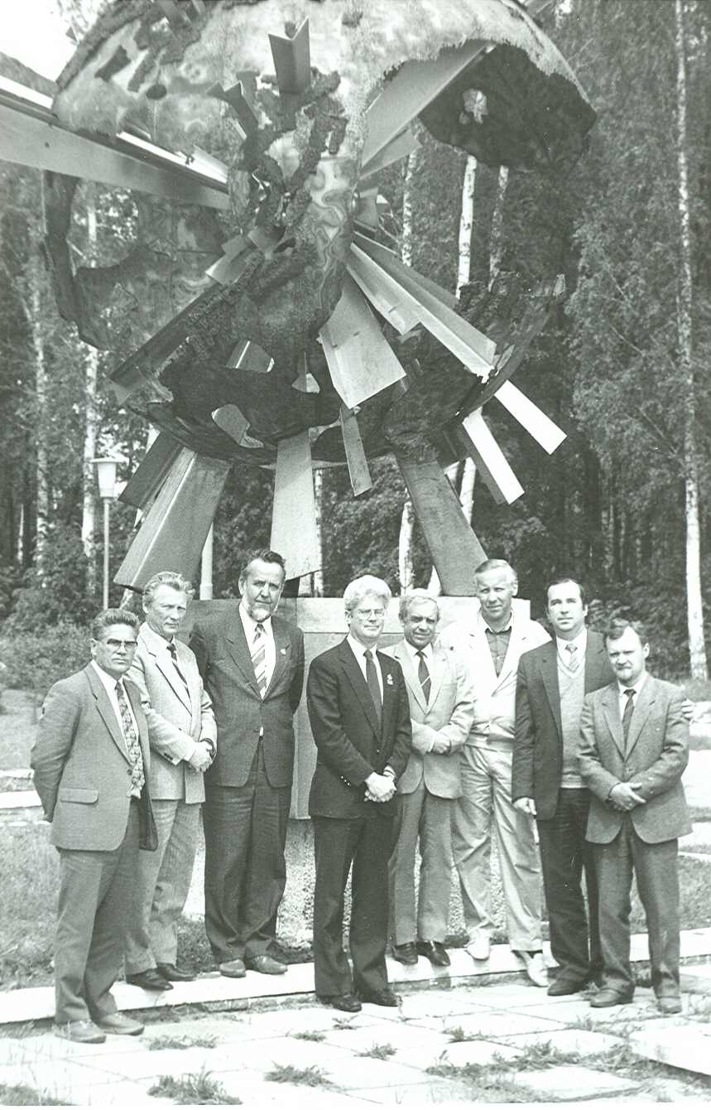

My first visit to RIAR in 1990
Thanks for your attention!
Questions?
My last visit to RIAR in 2014

Slide 48
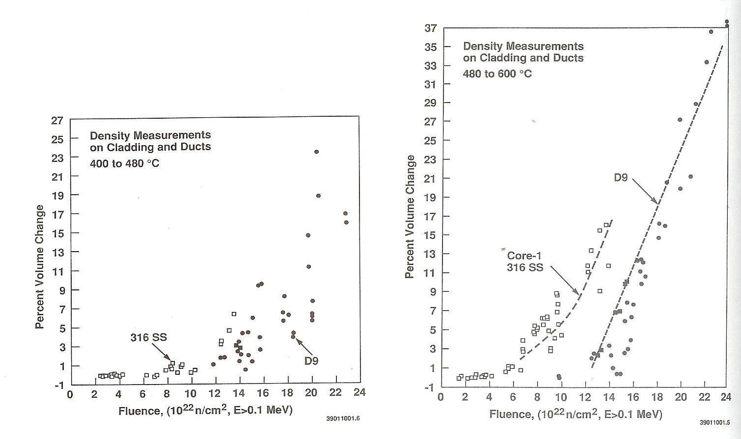
Comparison of volume changes observed in FFTF of CW 316 and CW D9 fuel cladding
Makenas et al., 1990
One heat of 316 SS and a number of heats of D9
Both duct and cladding data included from four driver fuel assemblies irradiated in FFTF.
>480°C
<480°C°
Large amount of data scatter

Slide 49
Comparison of volume changes observed in FFTF of CW 316 and CW D9 fuel cladding
Makenas et al., 1990
One heat of 316 SS and a number of heats of D9
Both duct and cladding data included from four driver fuel assemblies irradiated in FFTF.
>480°C
<480°C°
Large amount of data scatter
Is this really “inherent” chaotic scatter …. or is there additional information related to differences in composition, temperature, dose and dose rate?

Slide 50
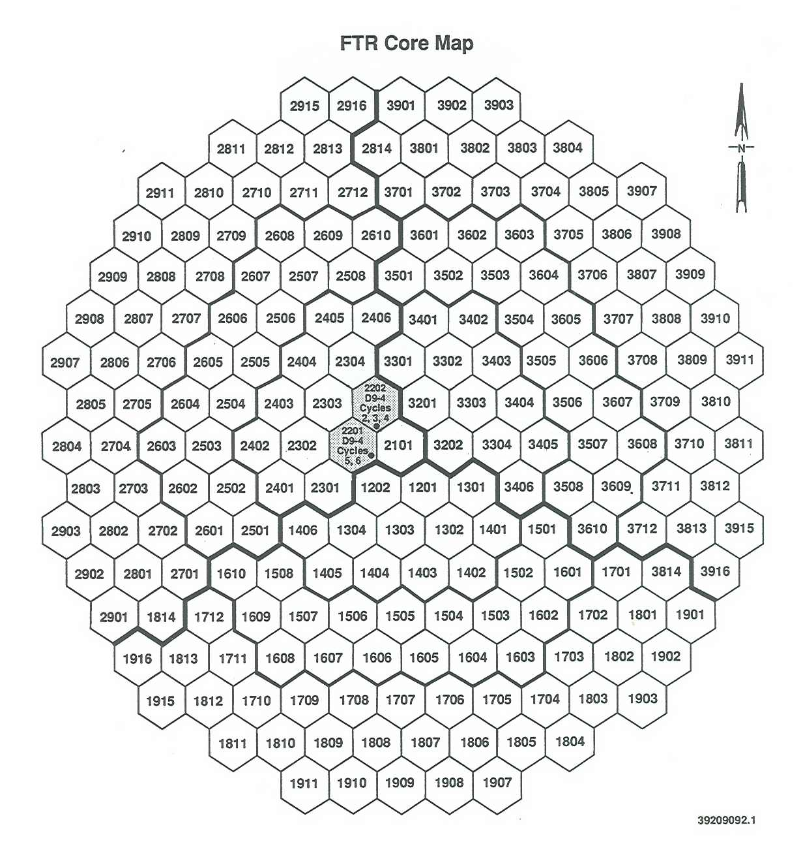
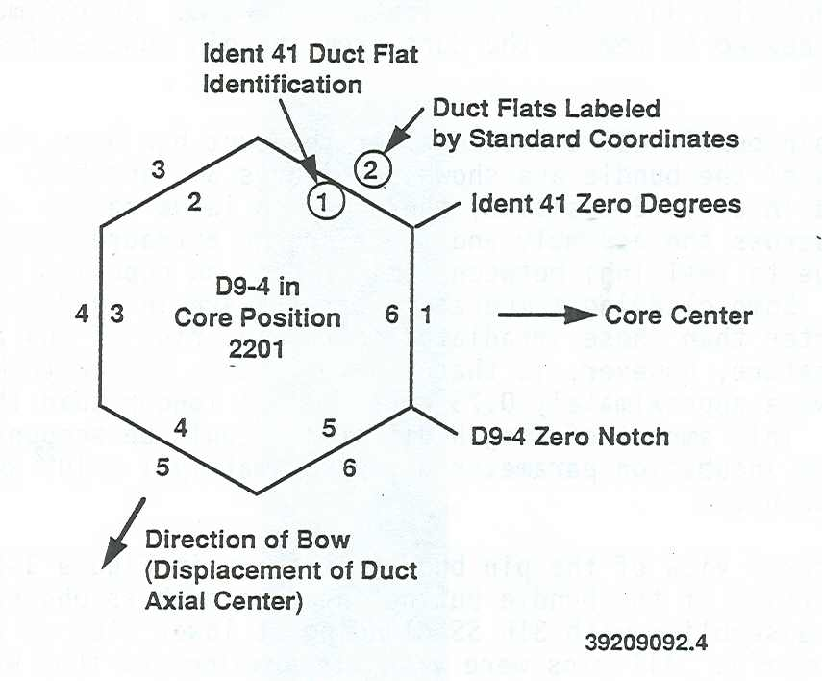
Irradiation of D9-4 in two positions in row 2

Slide 51
Irradiation of D9-4 in two positions in row 2
D9-2 was irradiated in only one position in row 4.

Slide 52
Comparison of swelling of two cladding heats in D9-4 assembly
D9-C1P
Difference is due primarily to the effect of lower phosphorus level to produce higher swelling and also a narrower loop.
D9-C1

