Slide 1
Effects of irradiation on susceptibility of ferritic-martensitic steels to liquid metal embrittlement in liquid lead-bismuth environment
S. Gavrilov, E. Stergar, M. Lambrechts, M. Konstantinovic, J. Van den Bosch
XI Conference on Reactor Materials Science, Dimitrovgrad, May 27-31, 2019

Slide 2
Overview
MYRRHA project
Liquid metal embrittlement phenomenology
LME issues for design
Irradiation experiments
  TWIN-ASTIR (BR2)
  LEXUR II (BOR 60)
  MEGAPIE (PSI)
Options to handle LME
Summary

Slide 3

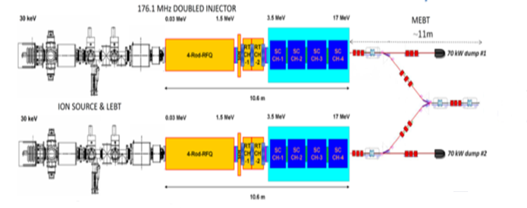

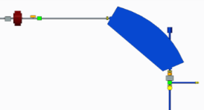
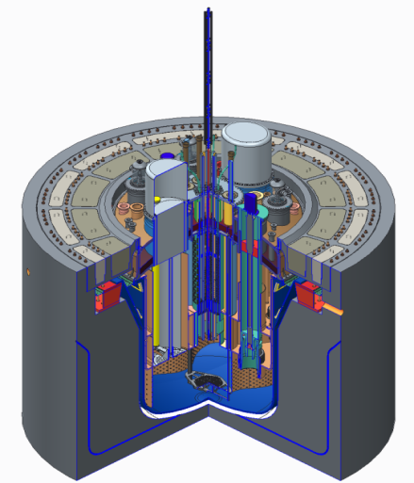
MYRRHA
MYRRHA – An Accelerator Driven System
  Demonstrate the ADS concept at pre-industrial scale
    Can operate in critical and sub-critical modes
  Demonstrate transmutation
  Fast neutron source → multipurpose and flexible
  irradiation facility
Target
main reaction | spallation
output | 2·10¹⁷ n/s
material | LBE (coolant)
Accelerator
particles | protons
beam energy | 600 MeV
beam current | 2.4 to 4 mA
Reactor
power | 65 to 100 MW_{th}
k_{eff} | 0,95
spectrum | fast
coolant | LBE

Slide 4
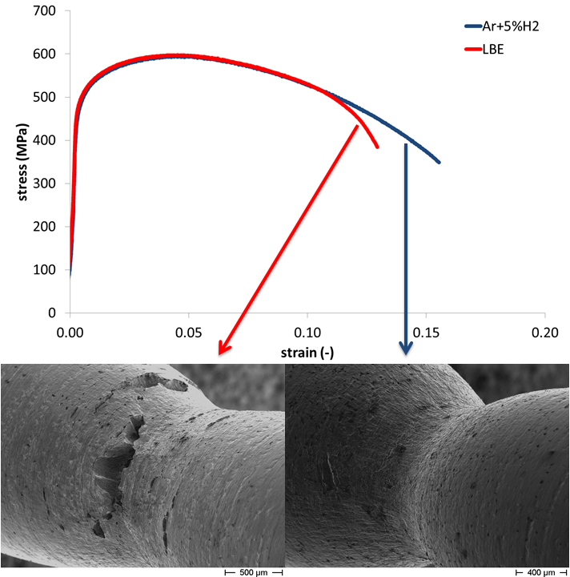
Liquid Metal Embrittlement (LME) effect
Example of Liquid Metal Embrittlement
Degradation of steel’s mechanical properties in contact with liquid metal
Potentially can affect:
Tensile properties
  Total elongation
Fracture toughness
T91
350 °C

Slide 5
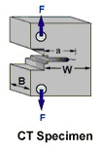
LME: Fracture toughness
Test environment | Test temperature (°C) | Pre-cracking environment | Average J_{Q} (kJ/m²) | Fracture surface
Ar-5%H₂ | 350 | Air | 417 ± 23 | Ductile
LBE | 350 | Air | 303 ± 4 | Ductile with quasi-cleavage side cracks
LBE | 350 | LBE | 63 ± 14 | Quasi-cleavage
0.5” CT specimen
(W=25 mm, B=12.5 mm)
85 % reduction in fracture toughness in LBE
Feyzan Ersoy, Serguei Gavrilov, Kim Verbeken, Investigating liquid-metal embrittlement of T91 steel by fracture toughness tests, Journal of Nuclear Materials, Volume 472, 2016,171-177,

Slide 6
LME issues for design
If steel susceptible to LME can be used for fuel assembly?
  EOF radiation embrittlement >> LME
  Reactor specific loading history
If steel susceptible to LME can be used for structural components by reducing the design mechanical properties correspondingly?
Synergetic effect of irradiation and liquid metal environment on mechanical properties
  If radiation induced modification of mechanical properties can affect susceptibility of steels to LME
…

Slide 7
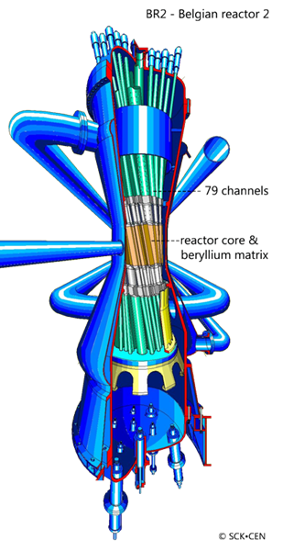
TWIN-ASTIR irradiation experiment
Irradiation conditions:
LBE: 460 ÷ 490 °C
PWR: water: 300-320 °C
Damaging doses: 1.6-2.6 dpa
Testing:
SSRT
300÷450 °C
LBE
Strain rate: 5x10⁻⁵ s⁻¹

Slide 8
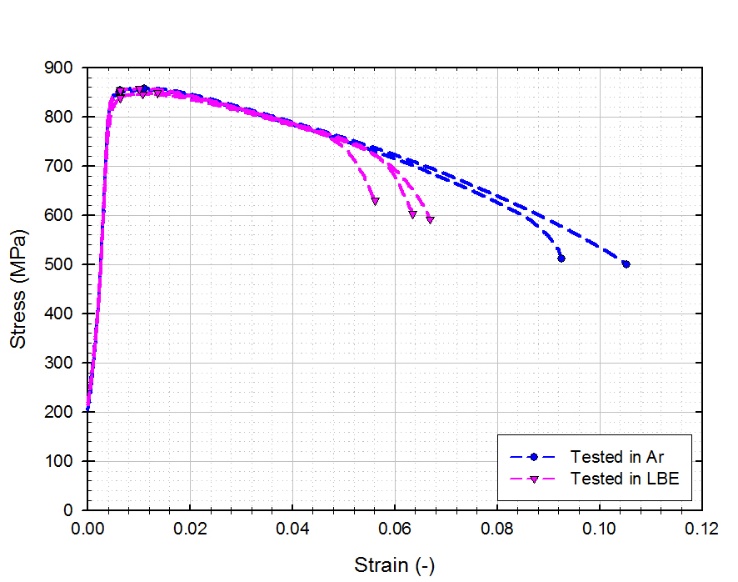
TWIN-ASTIR irradiation experiment (BR2)
Ar
400 µm
LBE
Stress-strain curves of T91 steel irradiated in water at 300 °C to 2.5 dpa. T_{test}=T_{irr}= 300 °C,
strain rate 5·10⁻⁵s⁻¹. Tests performed in argon and in LBE with [O]: 10⁻⁸ ÷ 10⁻⁶ wt.%.
500 µm

Slide 9



LEXUR II: Contributors
Sergey Eremin
Anna Lebedeva
Igor Zhemkov
Yury Revyakin
Oleg Makarov
Valeriy Iakovlev
Nikolai Poglyad
Larisa Bolotova
A. Plotnikov
…
Ludo Eysermans
Roger Mertens
Ivan Fets
Marlies Lambrecht
Erich Stergar
Marc Scibetta
Rachid Chaouadi
Serguei Gavrilov
Konstantza Lambrinou
…
Alessadro Gessi
Gianluca Benamati
Antonio Aiello
…
Abdou Almazouzi
E. Stergar, S.G. Eremin, S. Gavrilov, M. Lambrecht, N.S. Poglyad, I.Yu. Zhemkov, LEXUR-II-LBE an irradiation program in lead–bismuth to high dose, Journal of Nuclear Materials, 450(1–3), 2014, https://doi.org/10.1016/j.jnucmat.2013.11.016.

Slide 10
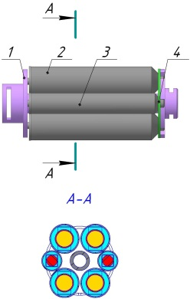
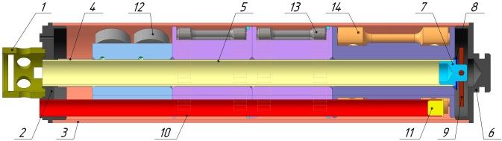
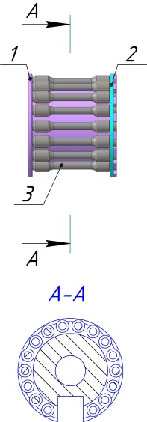
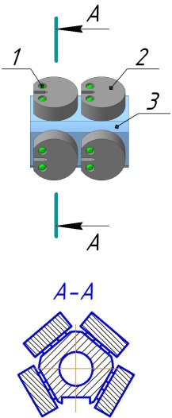
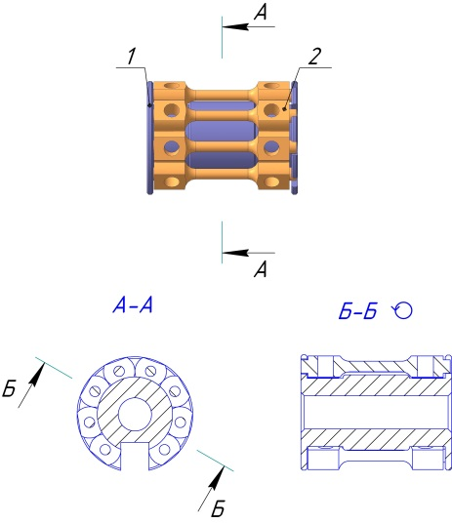


LEXUR II: BOR 60 Irradiation rig layout
LBE capsules T_{irr} 350 °C
Irradiation rig
Capsules holder
Holder with
pressurized tubes &
corrosion specimens capsules
Capsule with specimens for mechanical tests
Capsule with pressurized tube
Capsule with corrosion specimens

Slide 11
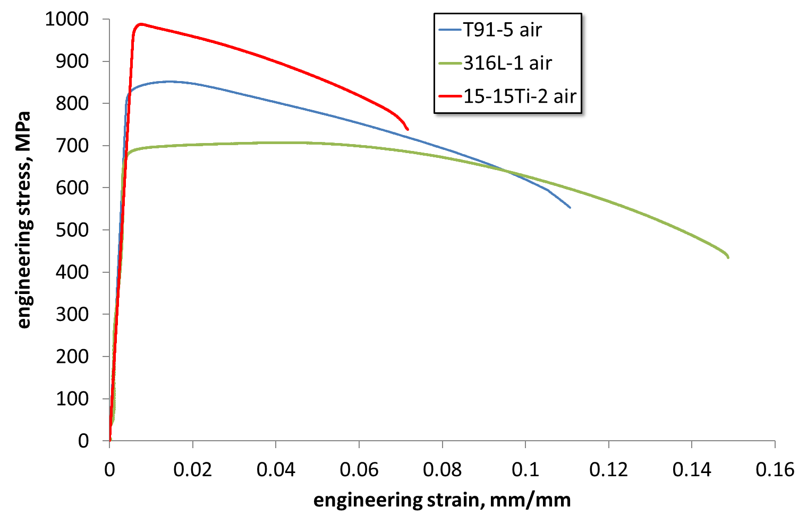
Comparison of irradiation effect on tensile properties of T91, 316L and 15-15Ti (6.1 dpa/350°C)
Specimen | T, | Yield, | UTS, | ε_{unif}, | ε_{tot}, | Dose,
 | °C | MPa | MPa | % | % | dpa
Т91-5 | 350 | 822 | 852 | 1.3 | 10.5 | 6.1
SS3164-1 | 350 | 664 | 708 | 4.2 | 14.4 | 6.1
15-15Ti-2 | 350 | 977 | 989 | 0.4 | 6.7 | 6.1
T_{test} = T_{irr} ≈ 350 °C
5·10⁻⁵ s⁻¹

Slide 12
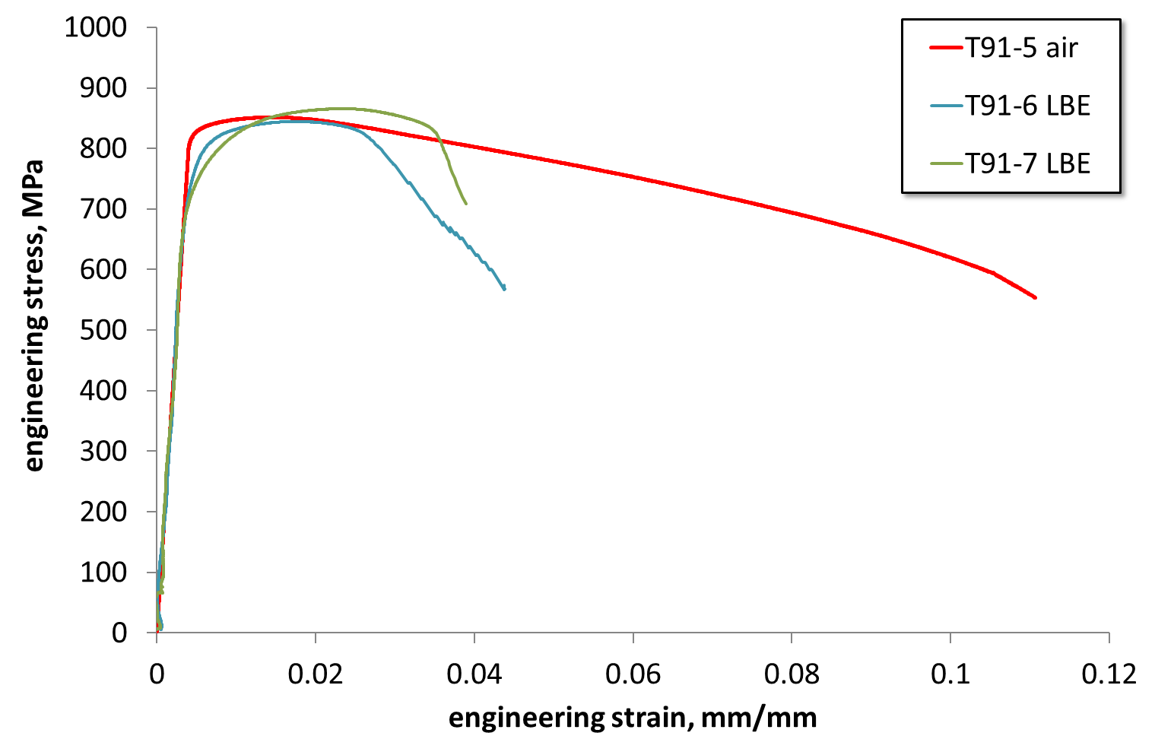
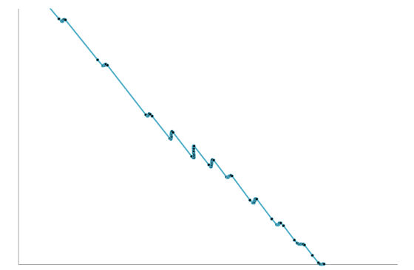
T91 tensile (LBE capsules)
Stress-strain curves for slow strain rate tests, at 5·10⁻⁵s⁻¹, of T91 steel irradiated in LBE at 350 °C to 6.1 dpa in air and in oxygen saturated LBE, at 350 °C.

Slide 13
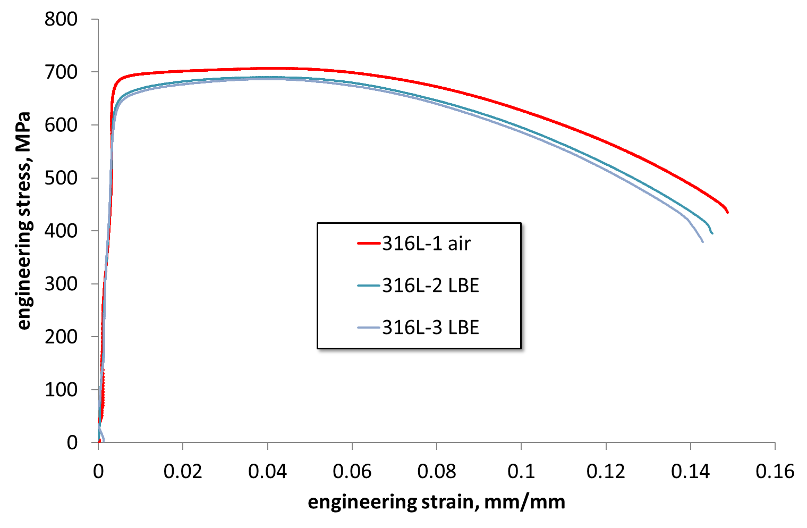
316L tensile ( 6.1 dpa/350°C/LBE)
Stress-strain curves for slow strain rate tests, at 5·10⁻⁵s⁻¹, of 316L steel irradiated in LBE at 350 °C to 6.1 dpa in air and in oxygen saturated LBE, at 350 °C.
E. Stergar, S.G. Eremin, S. Gavrilov, M. Lambrecht, O. Makarov, V. Iakovlev, Influence of LBE long term exposure and simultaneous fast neutron irradiation on the mechanical properties of T91 and 316L, Journal of Nuclear Materials, 473, 2016,
https://doi.org/10.1016/j.jnucmat.2016.02.008.

Slide 14
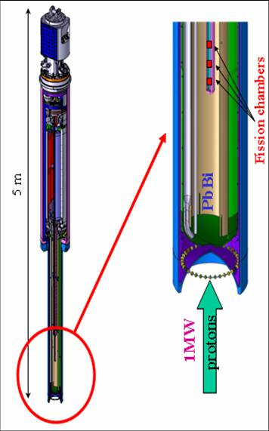
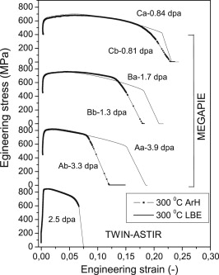
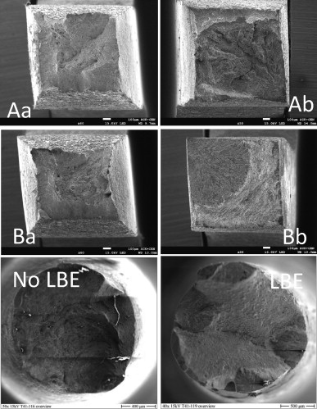
MEGAPIE
The SEM pictures of the broken surface of irradiated MEGAPIE and TWIN-ASTIR samples tested under high dose (A), medium dose (B) conditions, as well as those tested with (b) and without (a) the contact with LBE
MEGAPIE
Stress versus strain of the MEGAPIE and TWIN-ASTIR samples measured at 300 °C, with and without contact with LBE
M.J. Konstantinović, E. Stergar, M. Lambrecht, S. Gavrilov, Comparison of the mechanical properties of T91 steel from the MEGAPIE, and TWIN-ASTIR irradiation programs, Journal of Nuclear Materials, 2015, Available online 27 July 2015, http://dx.doi.org/10.1016/j.jnucmat.2015.07.038

Slide 15
Materials tested at SCK•CEN for susceptibility to Liquid Metal Embrittlement in LBE by SSRT
T91 DEMETRA heat - screening tests completed->susceptible
  irradiated - screening tests completed –> very susceptible
316L DEMETRA heat -> screening tests completed-> not susceptible
  Irradiated (up to 30dpa) –> not susceptible
1.4970 -> screening tests completed
  solution annealed –> not susceptible
  Cold Worked –> not susceptible
  Cold Worked+irradiated –> not susceptible
CLAM & Si doped CLAM –> susceptible
Eurofer 97 heat 2 – screening tests completed ->susceptible
EP-823 analog - screening tests completed – very susceptible
Si doped FeCr steels->screening tests completed –>very susceptible
Fe10CrAl (exp. heat) -> screening tests completed ->susceptible
ODS 9%, 12% & 14 %Cr -> screening tests completed ->susceptible

Slide 16
Options to handle LME for design
To use materials, which are not susceptible to LME
  Pro: qualification program -> demonstration of immunity
  Con: significant reduction of candidate materials number
  Challenges: to define “immunity”
Incorporation of LME by reduction of mechanical properties
  Pro: widening list of candidate materials
  Con: extensive R&D required
  Challenges: to define conservatism of the “reduction”
Mitigation techniques
  Pro: vanishing of susceptibility
  Con: questionable visibility
  Challenges: to define and justify mitigation strategy

Slide 17
Summary
T91 steel is susceptible to LME in LBE environment but intimate contact between steel and liquid metal is provided to observe it
T91 steel after neutron or combined neutron/proton irradiation shows enhanced susceptibility to LME in LBE
Austenitic stainless steels also after neutron irradiation do not show significant effect of LBE on tensile and fracture toughness property
Austenitic stainless steels (AISI 316L and DIN 1.4970) are selected for structural and fuel assembly components of MYRRHA reactor

Slide 18
Copyright © 2019 - SCK•CEN
PLEASE NOTE!
This presentation contains data, information and formats for dedicated use only and may not be communicated, copied, reproduced, distributed or cited without the explicit written permission of SCK•CEN.
If this explicit written permission has been obtained, please reference the author, followed by ‘by courtesy of SCK•CEN’.
Any infringement to this rule is illegal and entitles to claim damages from the infringer, without prejudice to any other right in case of granting a patent or registration in the field of intellectual property.
SCK•CEN
Studiecentrum voor Kernenergie
Centre d'Etude de l'Energie Nucléaire
Belgian Nuclear Research Centre
Stichting van Openbaar Nut
Fondation d'Utilité Publique
Foundation of Public Utility
Registered Office: Avenue Herrmann-Debrouxlaan 40 – BE-1160 BRUSSELS
Operational Office: Boeretang 200 – BE-2400 MOL

